Slide 1
Understanding Strong Allee effects in population models with a moving boundary
Xiaohan Zhou
Supervisors: Nabil Fadai, Reuben O'dea, Mainul Haque

Slide 2
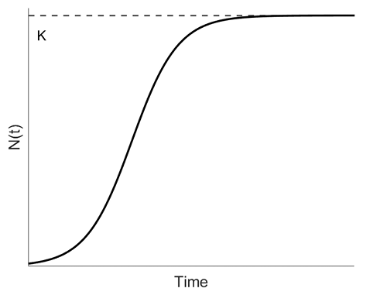
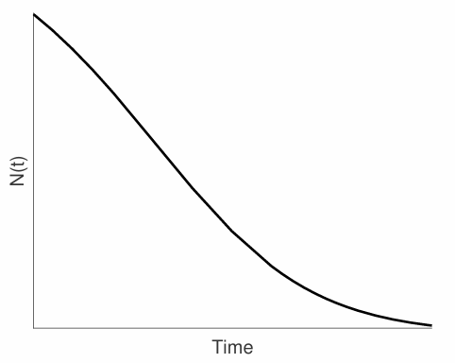
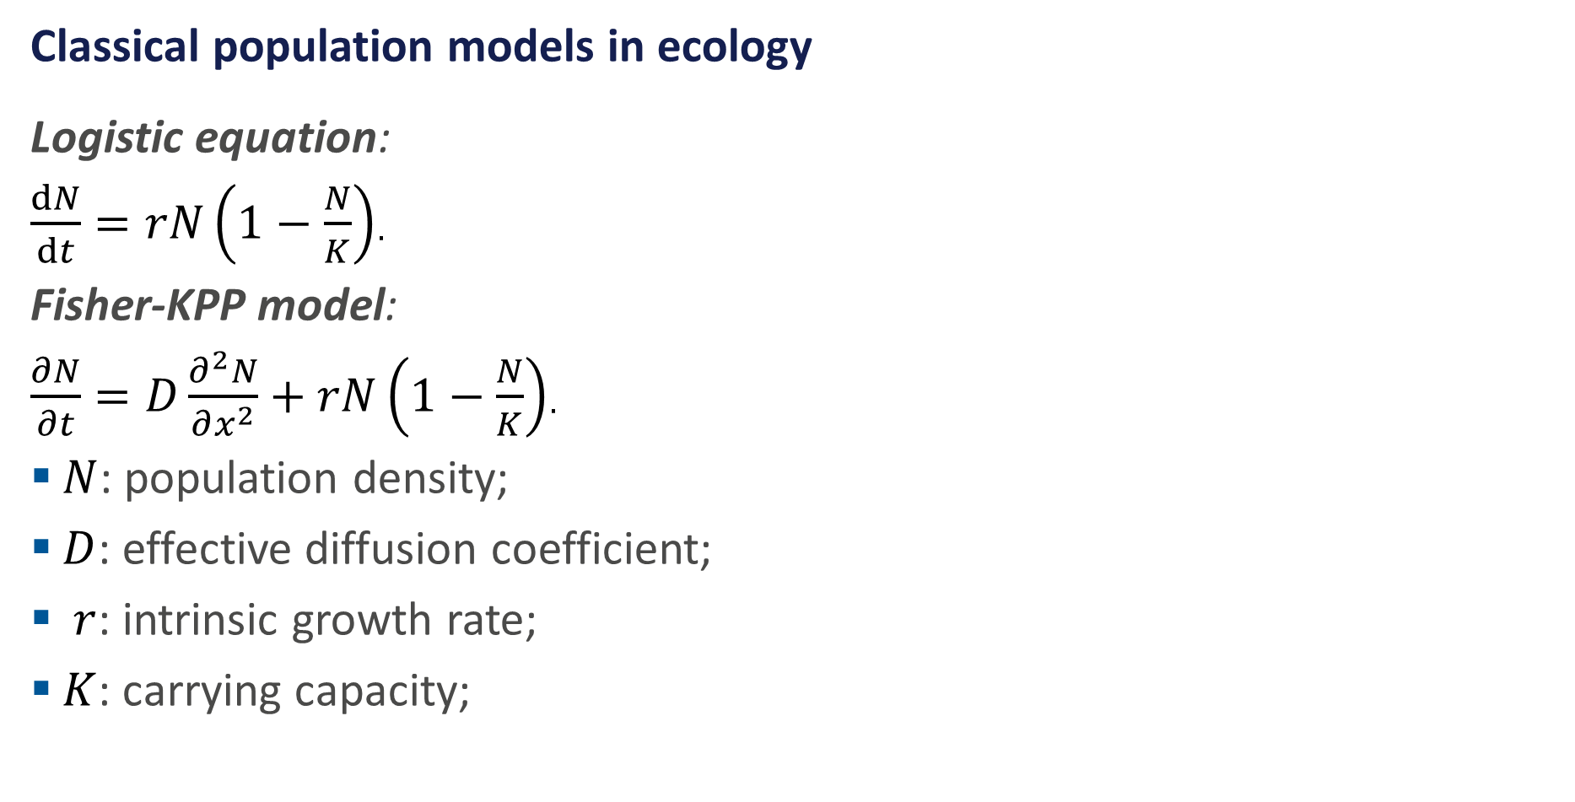
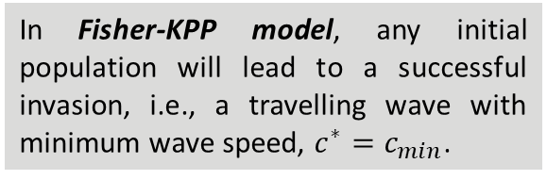
Introduction
Classical population models in ecology
Logistic equation:
$\frac{dN}{dt}=rN\left(1−\frac{N}{K}\right)$.
Fisher-KPP model:
$\frac{∂N}{∂t}=D\frac{∂^{2}N}{∂x^{2}}+rN\left(1−\frac{N}{K}\right)$.
$N$: population density;
$D$: effective diffusion coefficient;
$r$: intrinsic growth rate;
$K$: carrying capacity;
Travelling wave:
A population profile that moves through space at a constant speed without changing shape, it describes how species spread into new areas.
In Fisher-KPP model, any initial population will lead to a successful invasion, i.e., a travelling wave with minimum wave speed, $c^{∗}=c_{min}$.
Reality, small population may go extinct.

Slide 3
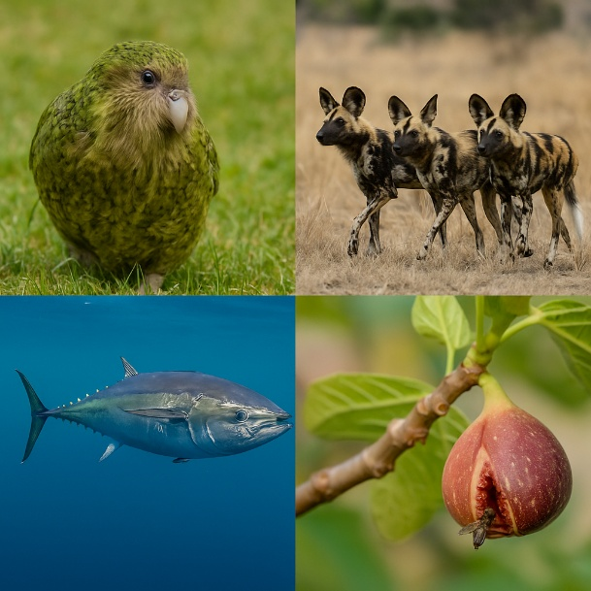
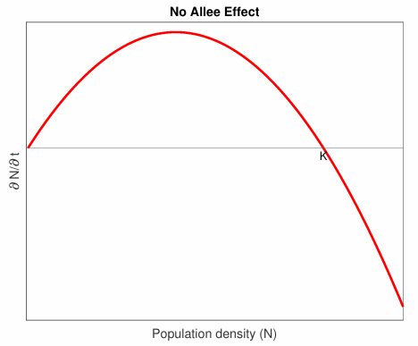
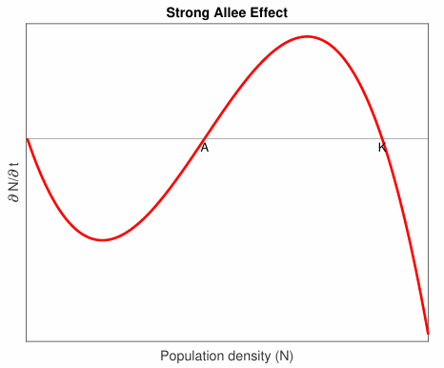
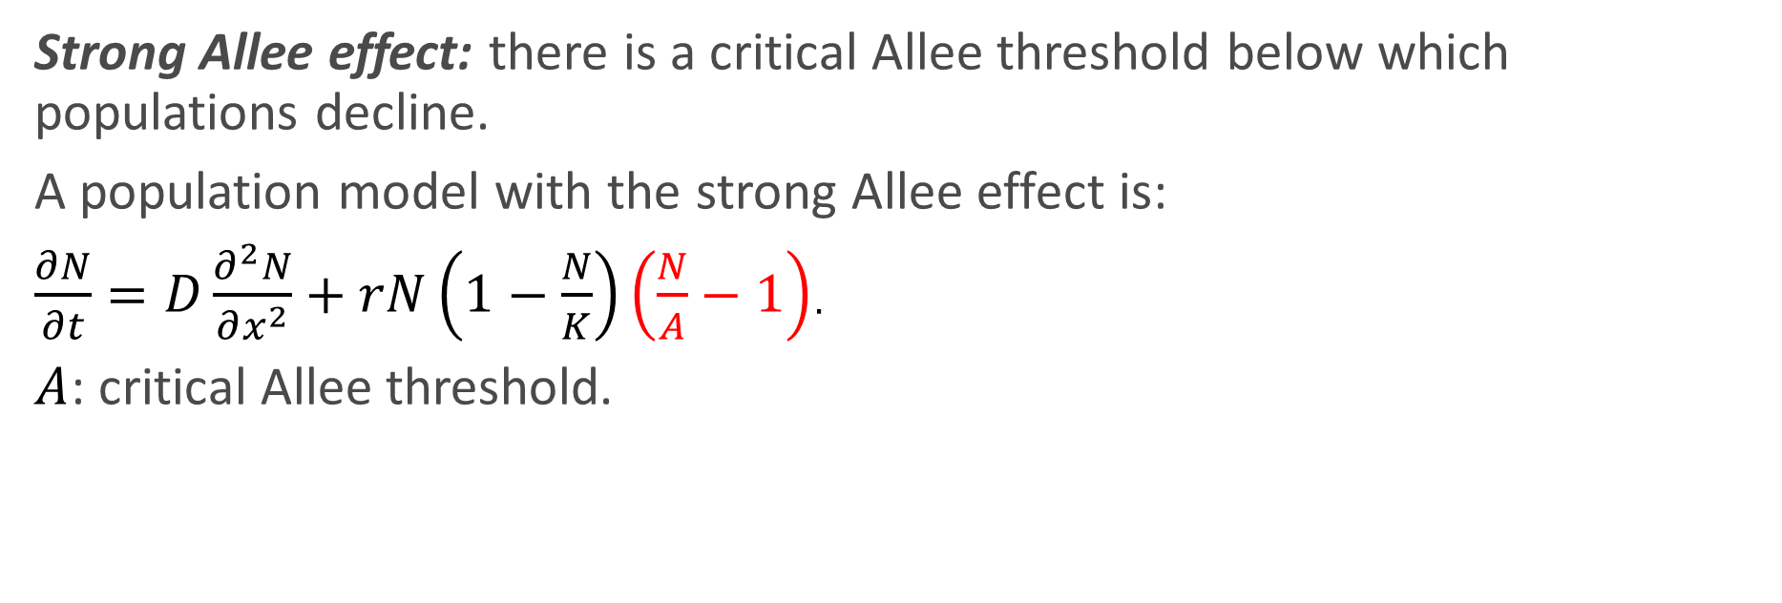
Strong Allee Effect
Strong Allee effect: there is a critical Allee threshold below which populations decline.
A population model with the strong Allee effect is:
$\frac{∂N}{∂t}=D\frac{∂^{2}N}{∂x^{2}}+rN\left(1−\frac{N}{K}\right)\left(\frac{N}{A}−1\right)$.
$A$: critical Allee threshold.

Slide 4
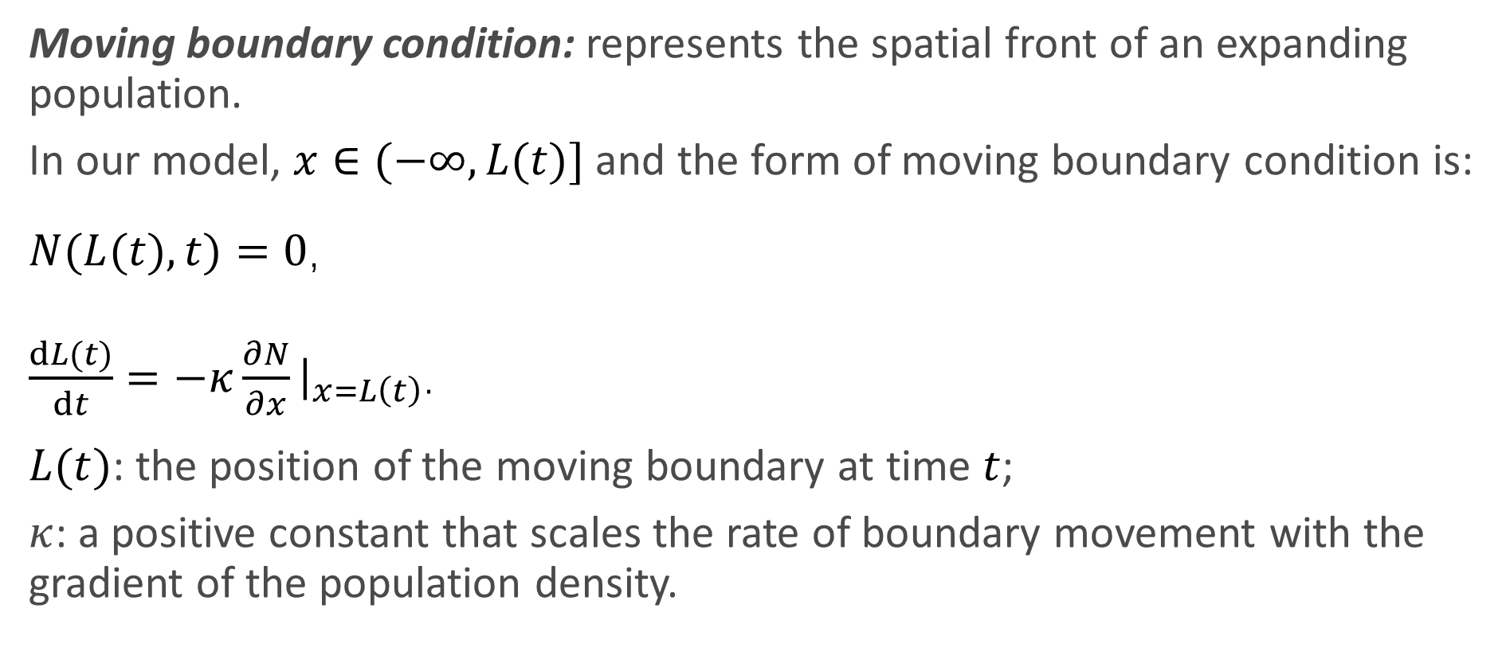
Moving Boundary Condition
Moving boundary condition: represents the spatial front of an expanding population.
In our model, $x∈(−∞, L(t)]$ and the form of moving boundary condition is:
$N(L(t),t)=0$,
$\frac{dL(t)}{dt}=−κ\frac{∂N}{∂x}{\left.​\right|}_{x=L\left(t\right)}$.
$L(t)$: the position of the moving boundary at time $t$;
$κ$: a positive constant that scales the rate of boundary movement with the gradient of the population density.
Cammarota D, Monteiro NZ, Menezes R, Fort H, Segura AM. Lotka–Volterra model with Allee effect: Equilibria, coexistence and size scaling of maximum and minimum abundance. Journal of Mathematical Biology.2023;87(6):82.
Liu L. A free boundary problem with a Stefan condition for a ratio-dependent predator-prey model. arXivpreprint arXiv:200914036. 2020.

Slide 5
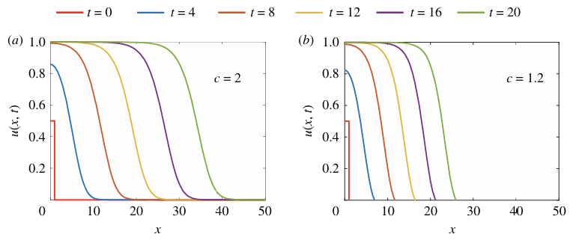
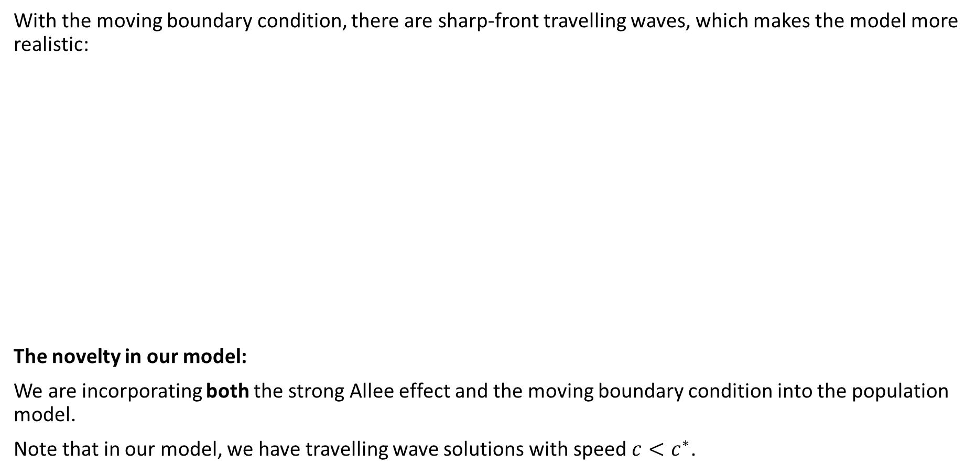
With the moving boundary condition, there are sharp-front travelling waves, which makes the model more realistic:
The novelty in our model:
We are incorporating both the strong Allee effect and the moving boundary condition into the population model.
Note that in our model, we have travelling wave solutions with speed ${c<c}^{∗}$.
The model without a moving boundary condition
The model with a moving boundary condition
El-Hachem M, McCue SW, Jin W, Du Y, Simpson MJ. Revisiting the Fisher–Kolmogorov-Petrovsky–Piskunovequation to interpret the spreading–extinction dichotomy. Proc R Soc A. 2019;475(2229):20190378.

Slide 6
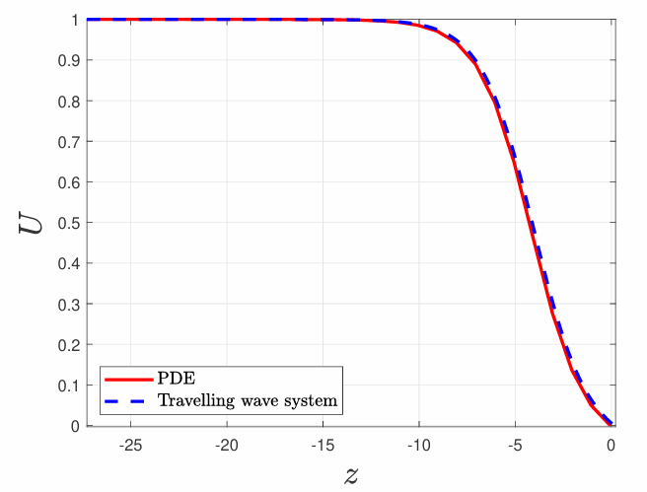
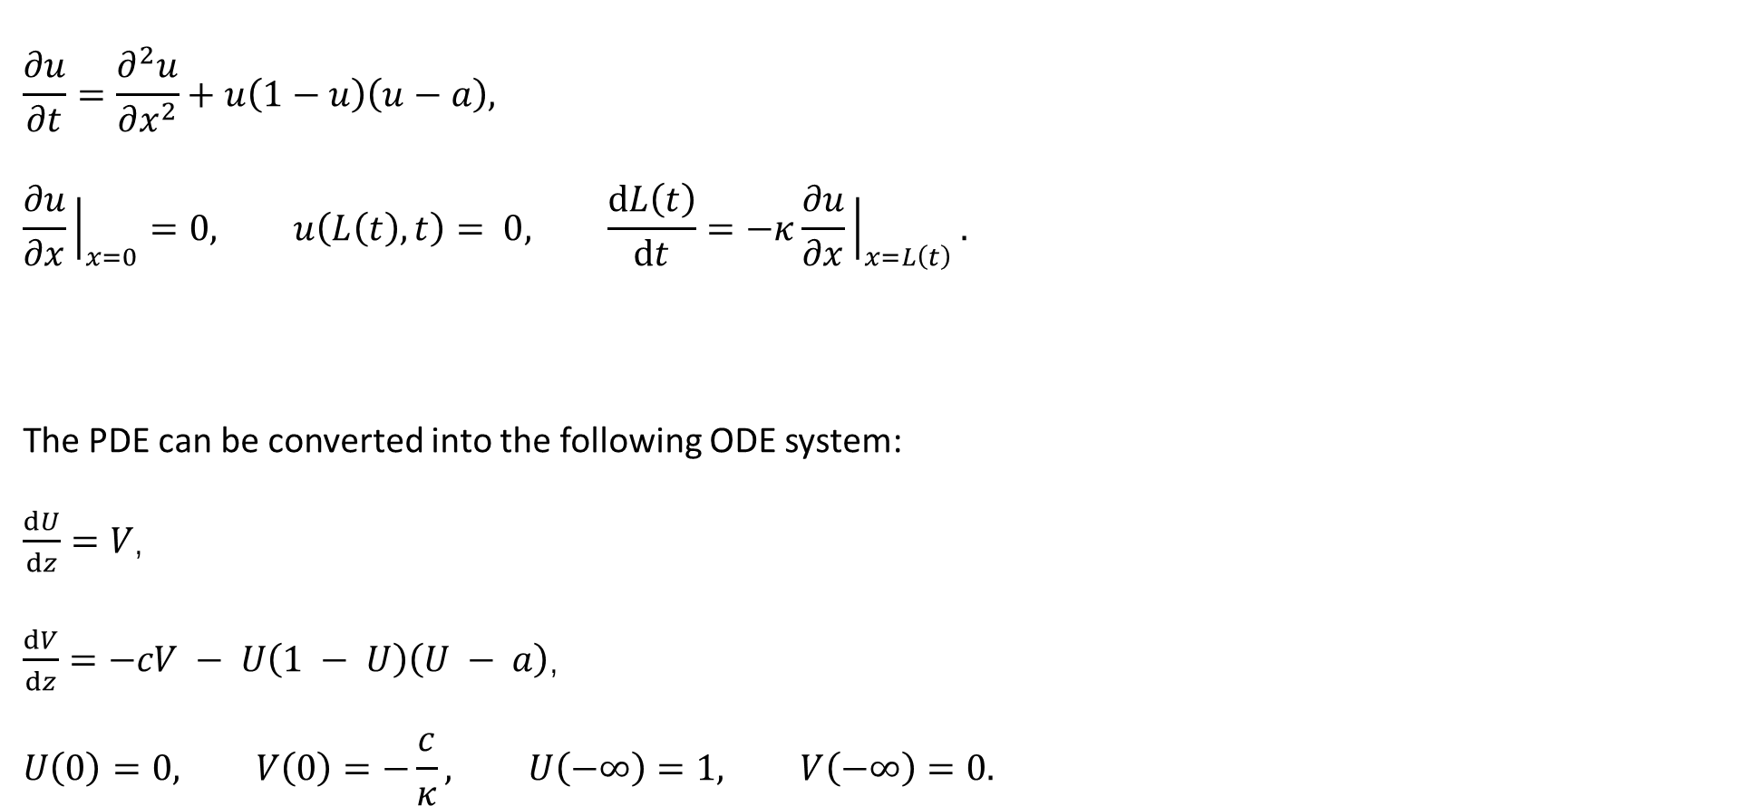
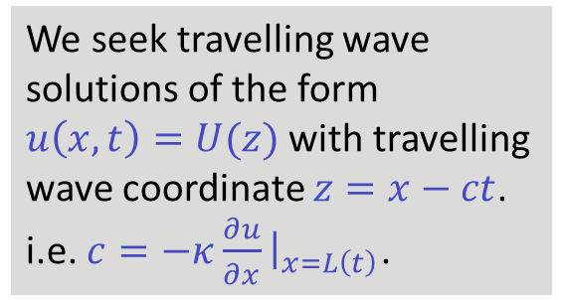
The Allee–Stefan model
Partial Differential Equation
$$\frac{∂u}{∂t}=\frac{∂^{2}u}{∂x^{2}}+u\left(1−u\right)\left(u−a\right),$$
$$\frac{∂u}{∂x}{\left.​\right|}_{x=0}=0, u\left(L\left(t\right),t\right)= 0, \frac{dL\left(t\right)}{dt}=−κ\frac{∂u}{∂x}{\left.​\right|}_{x=L\left(t\right)}.$$
The PDE can be converted into the following ODE system:
$\frac{dU}{dz}=V$,
$\frac{dV}{dz}=−cV − U\left(1 − U\right)\left(U − a\right)$,
$$U\left(0\right)=0, V\left(0\right)=−\frac{c}{κ}, U\left(−∞\right)=1, V\left(−∞\right)=0.$$
We seek travelling wave solutions of the form $u\left(x,t\right)=U(z)$ with travelling wave coordinate $z=x−ct$. i.e. $c=−κ\frac{∂u}{∂x}{\left.​\right|}_{x=L\left(t\right)}$.
Travelling wave system

Slide 7
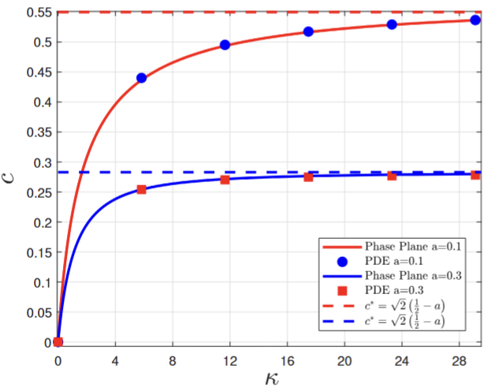
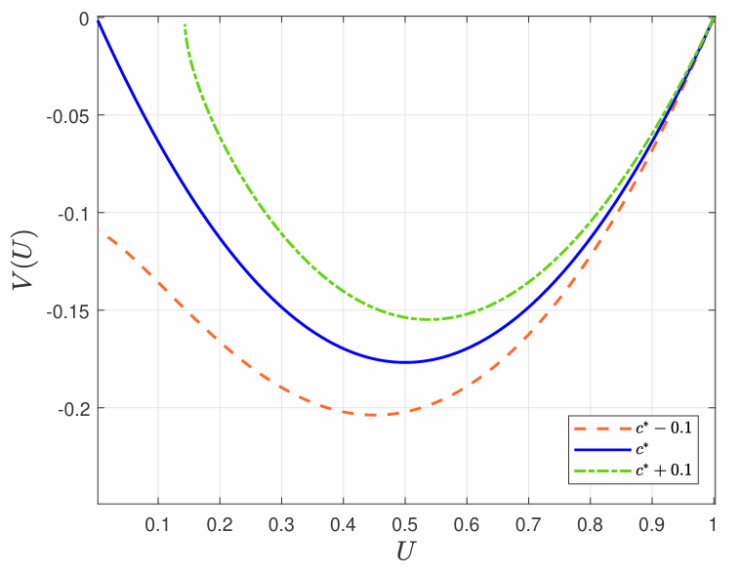
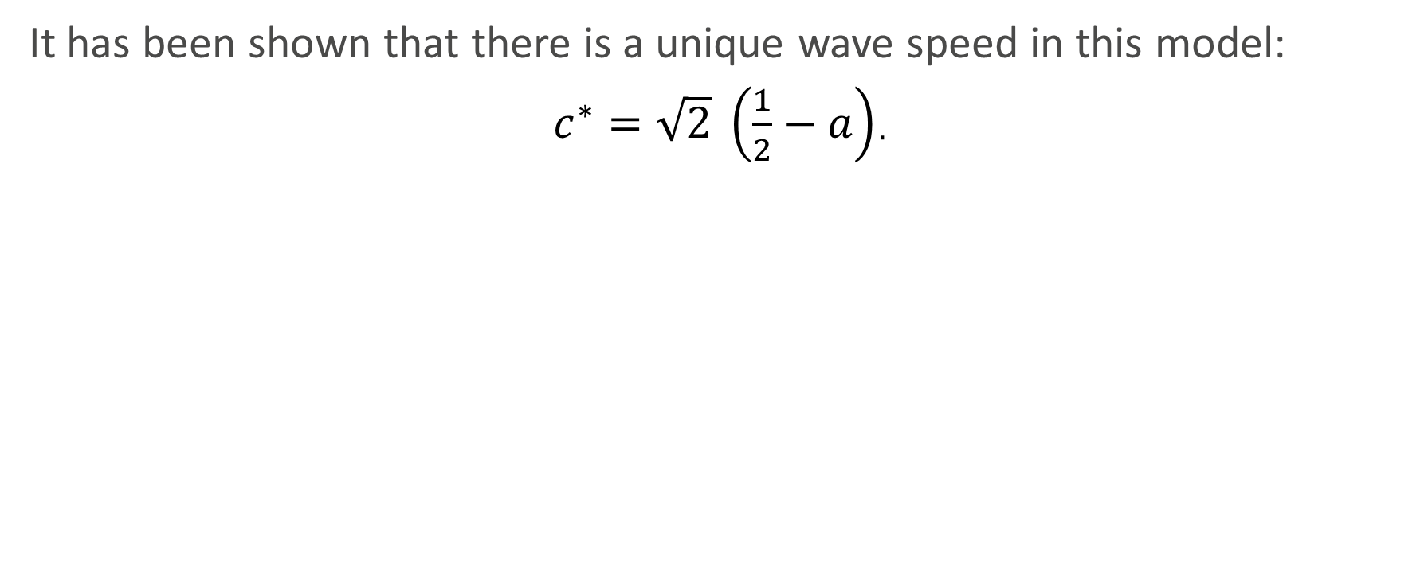
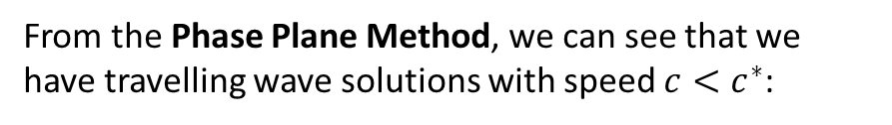
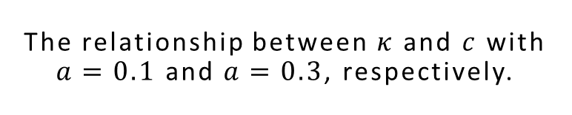
Results
It has been shown that there is a unique wave speed in this model:
$c^{∗}=\sqrt{2} \left(\frac{1}{2}−a\right)$.
The relationship between $κ$ and $c$ with $a=0.1$ and $a=0.3$, respectively.
From the Phase Plane Method, we can see that we have travelling wave solutions with speed ${c<c}^{∗}$:
Lewis MA, Kareiva P. Allee dynamics and the spread of invading organisms. Theoretical population biology.1993;43(2):141-58.

Slide 8
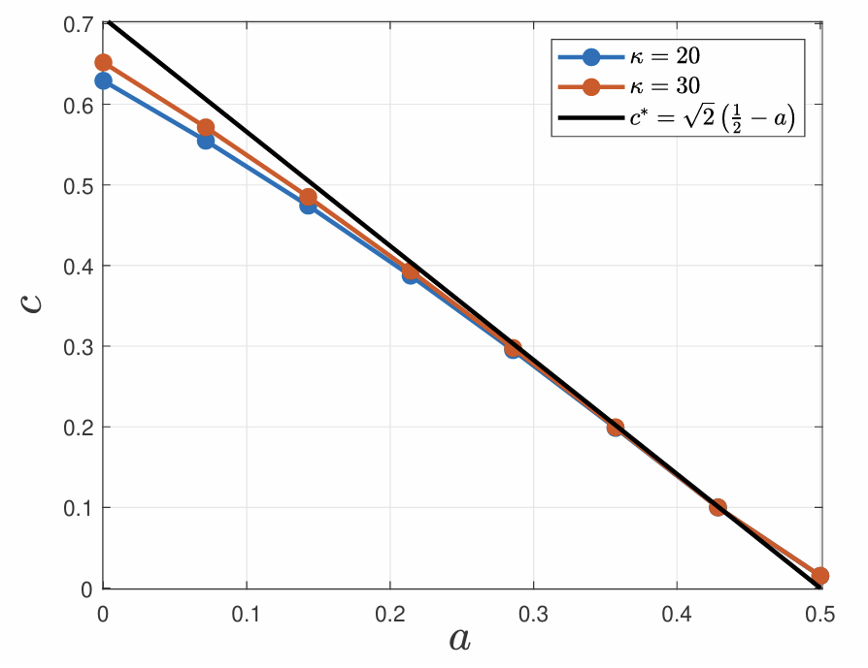
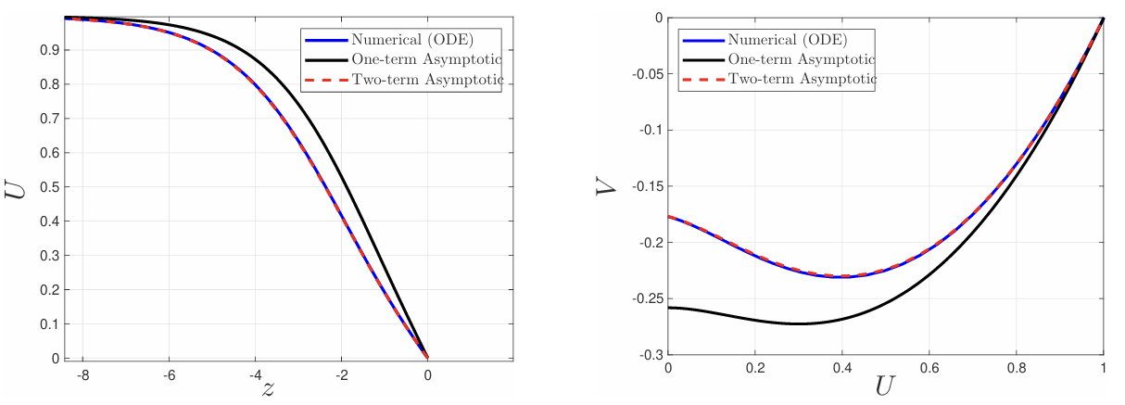
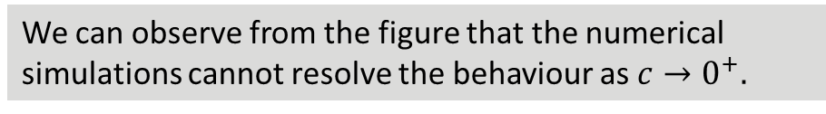
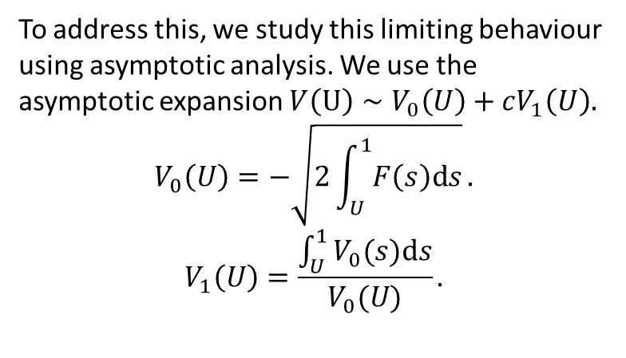
Asymptotic Analysis
We can observe from the figure that the numerical simulations cannot resolve the behaviour as $c→0^{+}.$
To address this, we study this limiting behaviour using asymptotic analysis. We use the asymptotic expansion $V\left(U\right)∼V_{0}\left(U\right)+cV_{1}\left(U\right).$
$$V_{0}\left(U\right)=−\sqrt{2\int_{U}^{1}{F\left(s\right)ds}}.$$
$$V_{1}\left(U\right)=\frac{\int_{U}^{1}{V_{0}(s)ds}}{V_{0}(U)}.$$
Fadai NT. Semi-infinite travelling waves arising in a general reaction–diffusion Stefan model. Nonlinearity.2021;34(2):725.

Slide 9
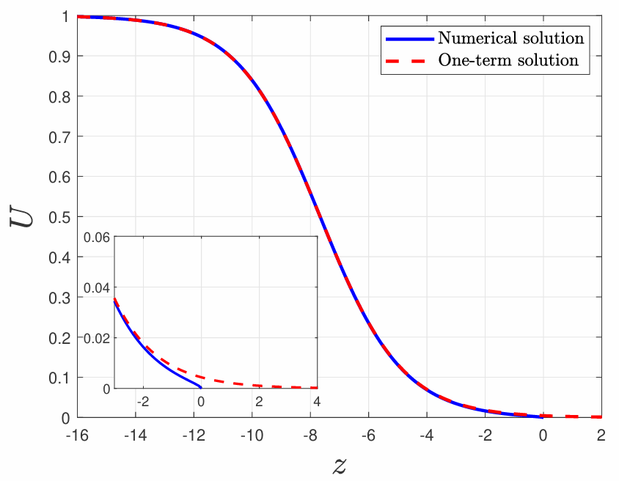
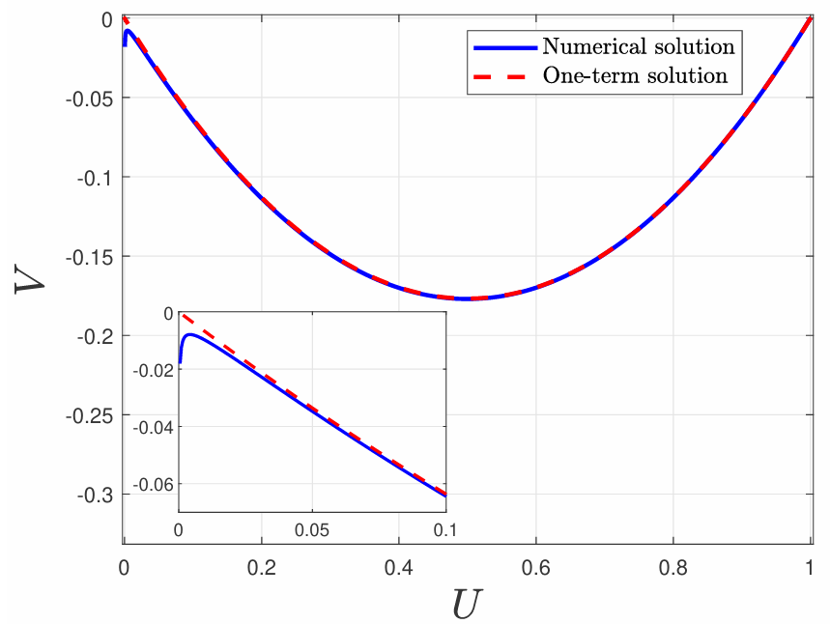
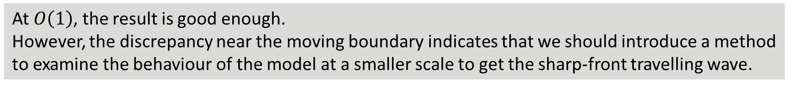
Asymptotic Analysis
Next, we study the model behaviour in the limiting regime $c→c^{∗−}$.
We used asymptotic analysis to study the behaviour of the solution as $c$ tends to $c^{∗−}$, by assuming $ε$ is small and
$c=c^{∗}−ε$. From the asymptotic expansion $U∼ U_{0}(z)+εU_{1}(z)$, we can get the result:
At $O\left(1\right)$, the result is good enough.
However, the discrepancy near the moving boundary indicates that we should introduce a method to examine the behaviour of the model at a smaller scale to get the sharp-front travelling wave.
Notes:
Having analysed c small, now c large

Slide 10

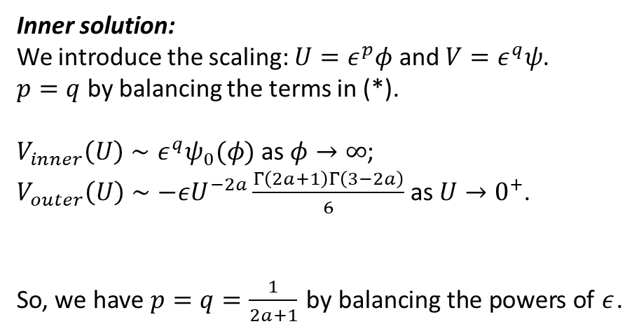
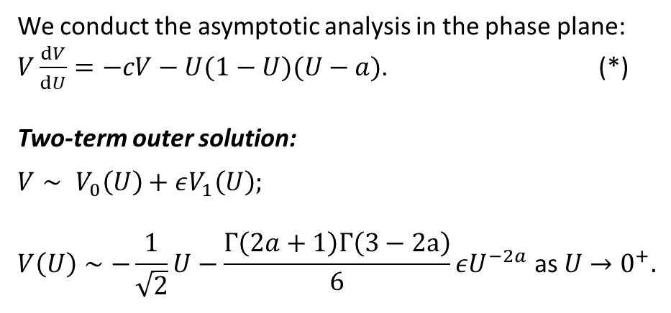
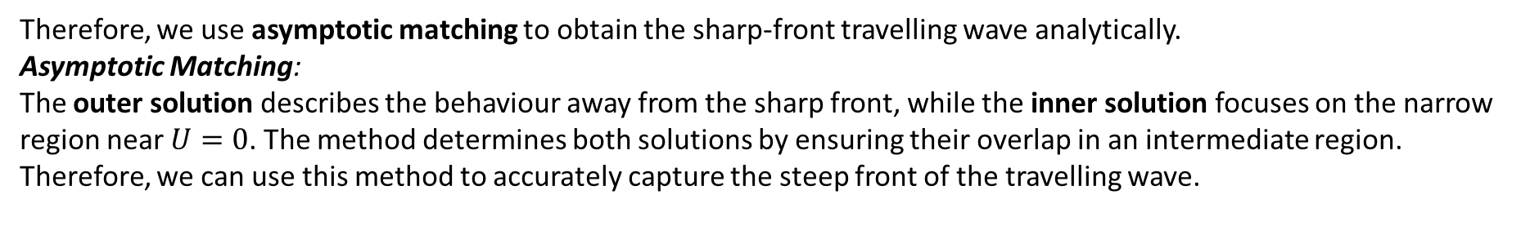
Asymptotic Analysis
Therefore, we use asymptotic matching to obtain the sharp-front travelling wave analytically.
Asymptotic Matching:
The outer solution describes the behaviour away from the sharp front, while the inner solution focuses on the narrow region near $U=0$. The method determines both solutions by ensuring their overlap in an intermediate region. Therefore, we can use this method to accurately capture the steep front of the travelling wave.
We conduct the asymptotic analysis in the phase plane:
$V\frac{dV}{dU}=−cV−U(1−U)(U−a)$. (*)
Two-term outer solution:
$$V∼ V_{0}\left(U\right)+εV_{1}\left(U\right);$$
$$V\left(U\right)∼−\frac{1}{\sqrt{2}}U−\frac{Γ\left(2a+1\right)Γ\left(3−2a\right)}{6}εU^{−2a} \text{as} U→0^{+}.$$
Inner solution:
We introduce the scaling: $U=ε^{p}φ$ and $V=ε^{q}ψ$.
$p=q$ by balancing the terms in (*).
$V_{inner}\left(U\right)∼ε^{q}ψ_{0}(φ)$ as $φ→∞$;
$V_{outer}\left(U\right)∼−εU^{−2a}\frac{Γ\left(2a+1\right)Γ\left(3−2a\right)}{6}$ as $U→0^{+}$.
So, we have $p=q=\frac{1}{2a+1}$ by balancing the powers of $ε$.
$$ε^{1−2ap}$$
Fadai NT. Semi-infinite travelling waves arising in a general reaction–diffusion Stefan model. Nonlinearity.2021;34(2):725.
Notes:
Substitute
First term small
q=1-2ap

Slide 11
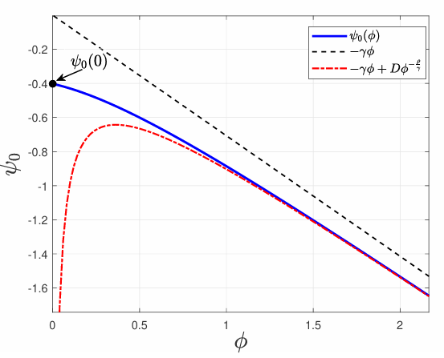
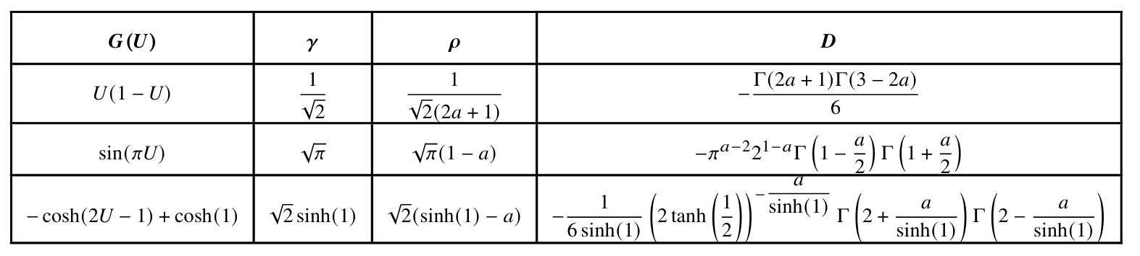
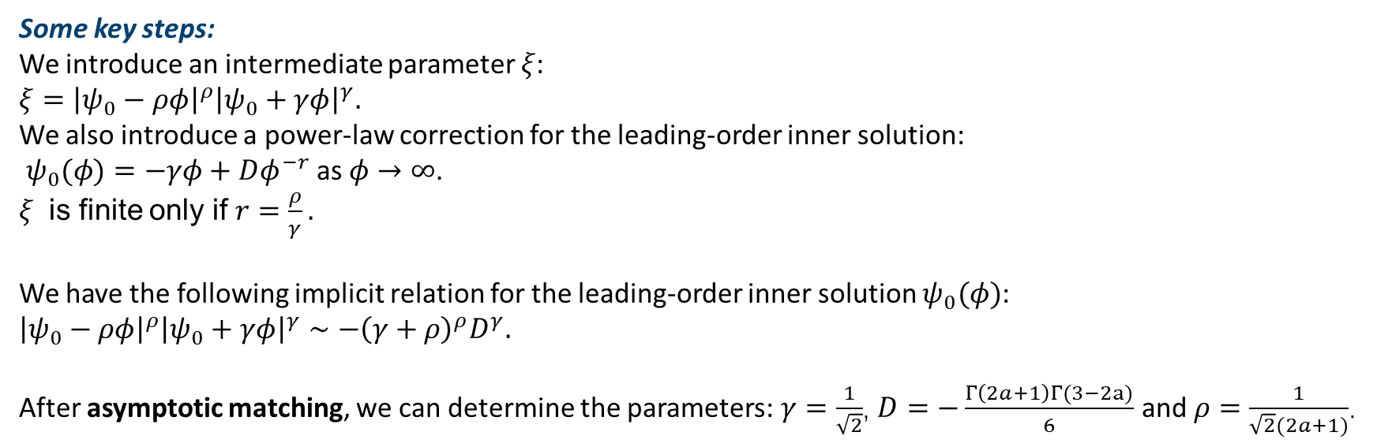
Asymptotic Analysis
Some key steps:
We introduce an intermediate parameter $ξ$:
$${ξ=\left|ψ_{0}−ρφ\right|}^{ρ}{\left|ψ_{0}+γφ\right|}^{γ}.$$
We also introduce a power-law correction for the leading-order inner solution:
$ψ_{0}(φ)=−γφ+Dφ^{−r}$ as $φ→∞$.
$ξ$ is finite only if $r=\frac{ρ}{γ}.$
We have the following implicit relation for the leading-order inner solution $ψ_{0}(φ)$:
$${\left|ψ_{0}−ρφ\right|}^{ρ}{\left|ψ_{0}+γφ\right|}^{γ}∼−{\left(γ+ρ\right)}^{ρ}D^{γ}.$$
After asymptotic matching, we can determine the parameters: $γ=\frac{1}{\sqrt{2}}$, $D=−\frac{Γ\left(2a+1\right)Γ(3−2a)}{6}$ and $ρ=\frac{1}{\sqrt{2}(2a+1)}$.
Nayfeh AH. Perturbation methods. John Wiley & Sons; 2024.
Notes:
Rho and gamma are constants to be determined in the matching
Power-law correction term does work in the matching condition phi \to \infty
G(U) logistic-like growth term

Slide 12
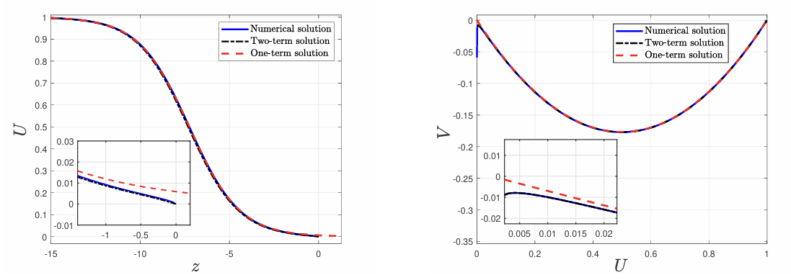
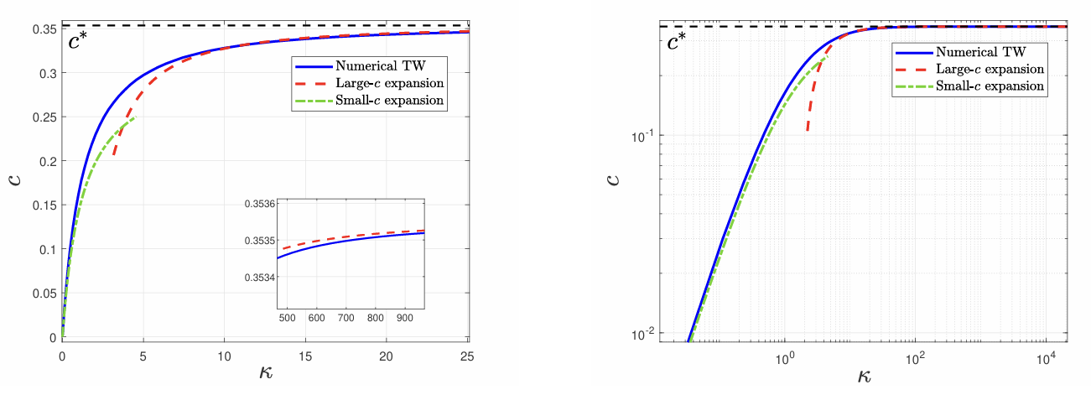
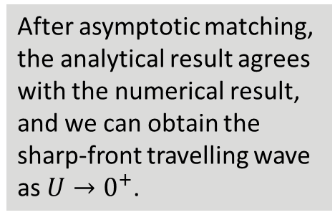
Results
The composite travelling wave profile combines the outer solution with the inner boundary-layer correction for $U<5ε$.
After asymptotic matching, the analytical result agrees with the numerical result, and we can obtain the sharp-front travelling wave as $U→0^{+}$.

Slide 13
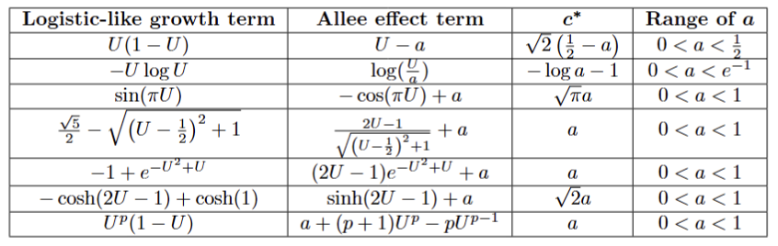
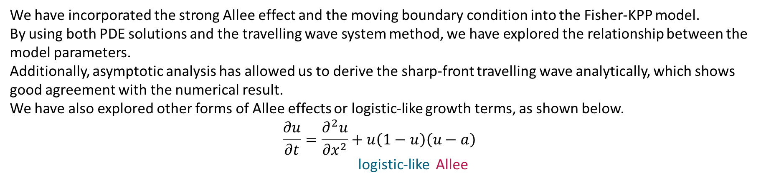
Conclusions & Future Work
We have incorporated the strong Allee effect and the moving boundary condition into the Fisher-KPP model.
By using both PDE solutions and the travelling wave system method, we have explored the relationship between the model parameters.
Additionally, asymptotic analysis has allowed us to derive the sharp-front travelling wave analytically, which shows good agreement with the numerical result.
We have also explored other forms of Allee effects or logistic-like growth terms, as shown below.
$$\frac{∂u}{∂t}=\frac{∂^{2}u}{∂x^{2}}+u\left(1−u\right)\left(u−a\right)$$
logistic-like Allee
For future work, we aim to extend the application of the strong Allee effect and the moving boundary condition to multi-species models, such as competition models.

Slide 14
Many thanks to my supervisors Nabil Fadai and Reuben O'dea for their help with my research
Please feel free to get in touch if you have any further questions:
sqyxz4@nottingham.ac.uk

Slide 15
Thank you!

