Slide 1
Quantum Many-Body Topology of Quasicrystals
Quasicrystals in Fundamental Physics
Edinburgh Futures Institute
Abhinav Prem (Bard College)
23rd July 2026

Slide 2




Collaborators
Dominic Else
(Perimeter)
Sheng-Jie Huang
(U Florida)
Andrey Gromov
(Meta)
Phys. Rev. X 11, 041051 (2021)

Slide 3



Quantum Many-Body Topology
Gapped
Topological phases: non-trivial pattern of many-body entanglement in the ground state
Quantum many-body system
Quantized responses
e.g. Hall conductance
Fractionalized excitations

Slide 4
Topological Phases of Matter with Symmetries
Topological phase #1
SET
SET
TO 1
TO 2
Symmetry
SPT
SPT
Topological phase #3
Trivial phase
TO 3
SB
SB
TO = topological order
SB = symmetry breaking phases
SPT = symmetry-protected topological phases
SET = symmetry-enriched topological phases
For example:
Topological insulators [protected by time-reversal symmetry]
Spin liquids [enriched by SO(3) symmetry]

Slide 5
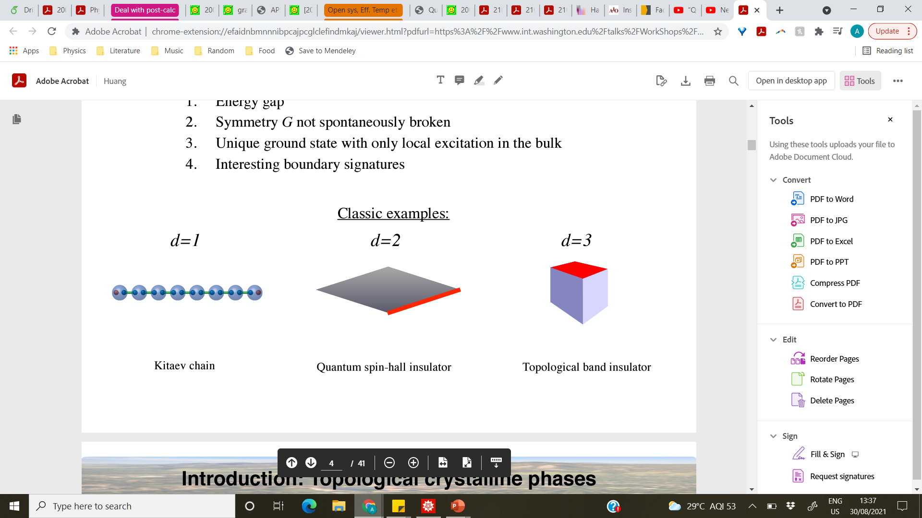
Symmetry Protected Topological Phases
T = 0 gapped phases of matter characterised by:
Symmetry G not spontaneously broken
Unique short-range entangled ground state
Only local excitations in the bulk
Non-trivial boundary signatures

Slide 6

Topological Crystalline Phases
Crystals possess space-group symmetry
Quantum many-body system

Slide 7
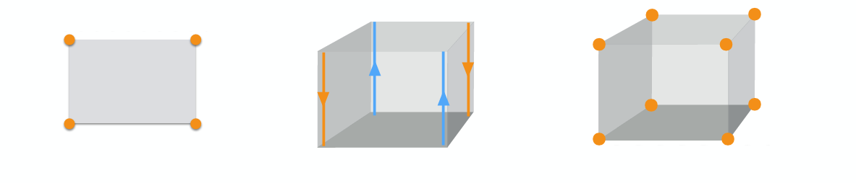
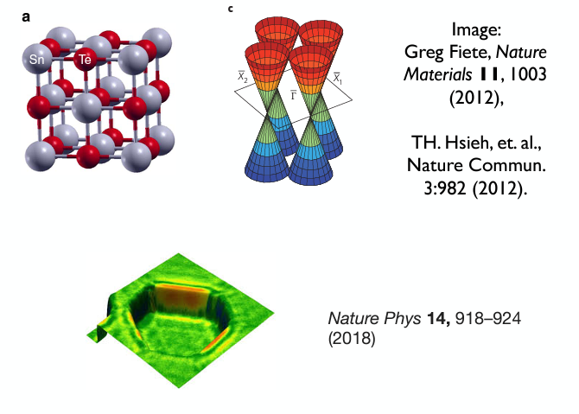
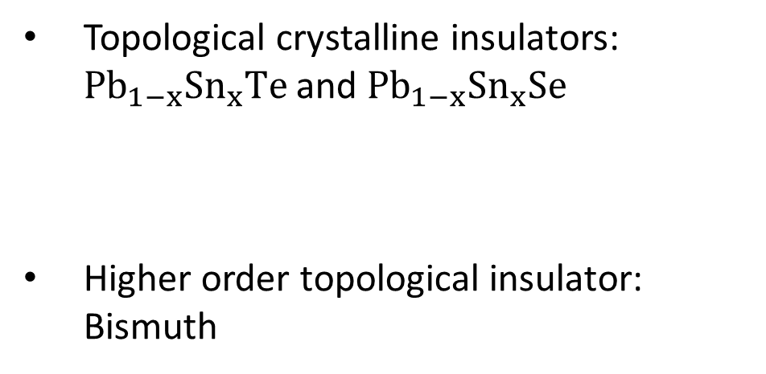
Topological Crystalline Phases
Inclusion of crystalline symmetries allows for rich new phases
Topological crystalline insulators: ${Pb}_{1−x}Sn_{x}Te$ and ${Pb}_{1−x}Sn_{x}Se$
Higher order topological insulator: Bismuth

Slide 8
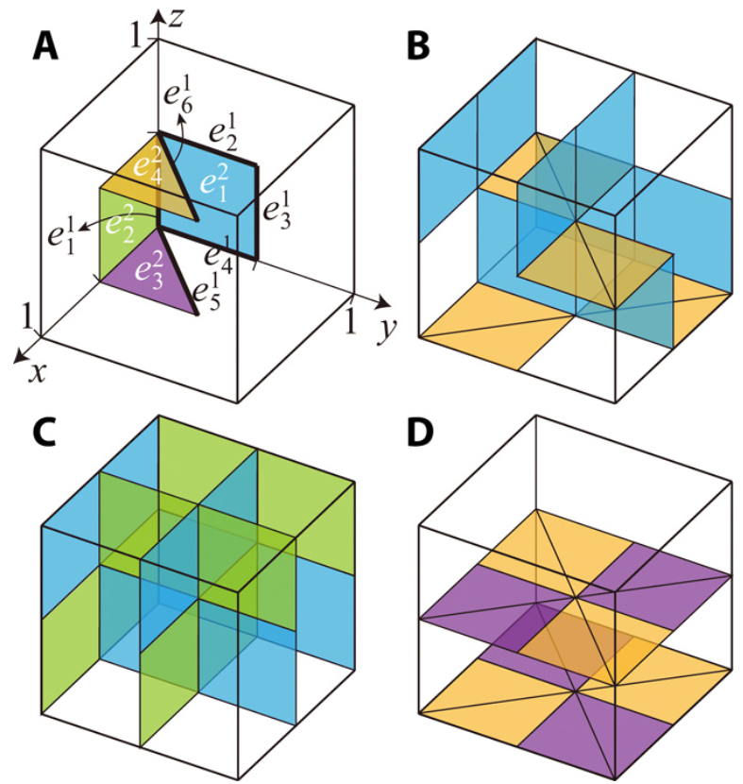
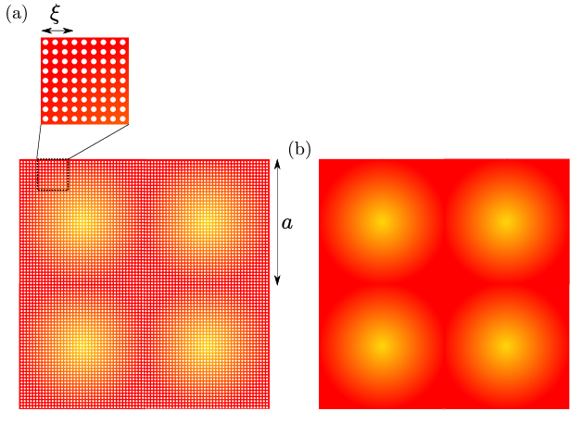
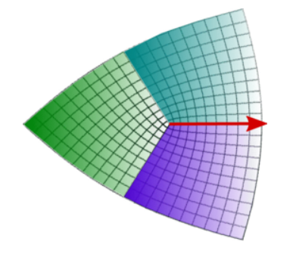
Topological Crystalline Phases
General approaches:
Topological crystals
(defect networks)
“Gauging” crystalline symmetry
Smooth states
Song, Huang, Fu, Hermele, PRX 2017
Huang, Song, Huang, Hermele, PRB 2017
Song, Huang, Qi, Fang, Hermele, Sci. Adv. 2019
Thorngren and Else, PRX 2018
Else and Thorngren, PRB 2019

Slide 9
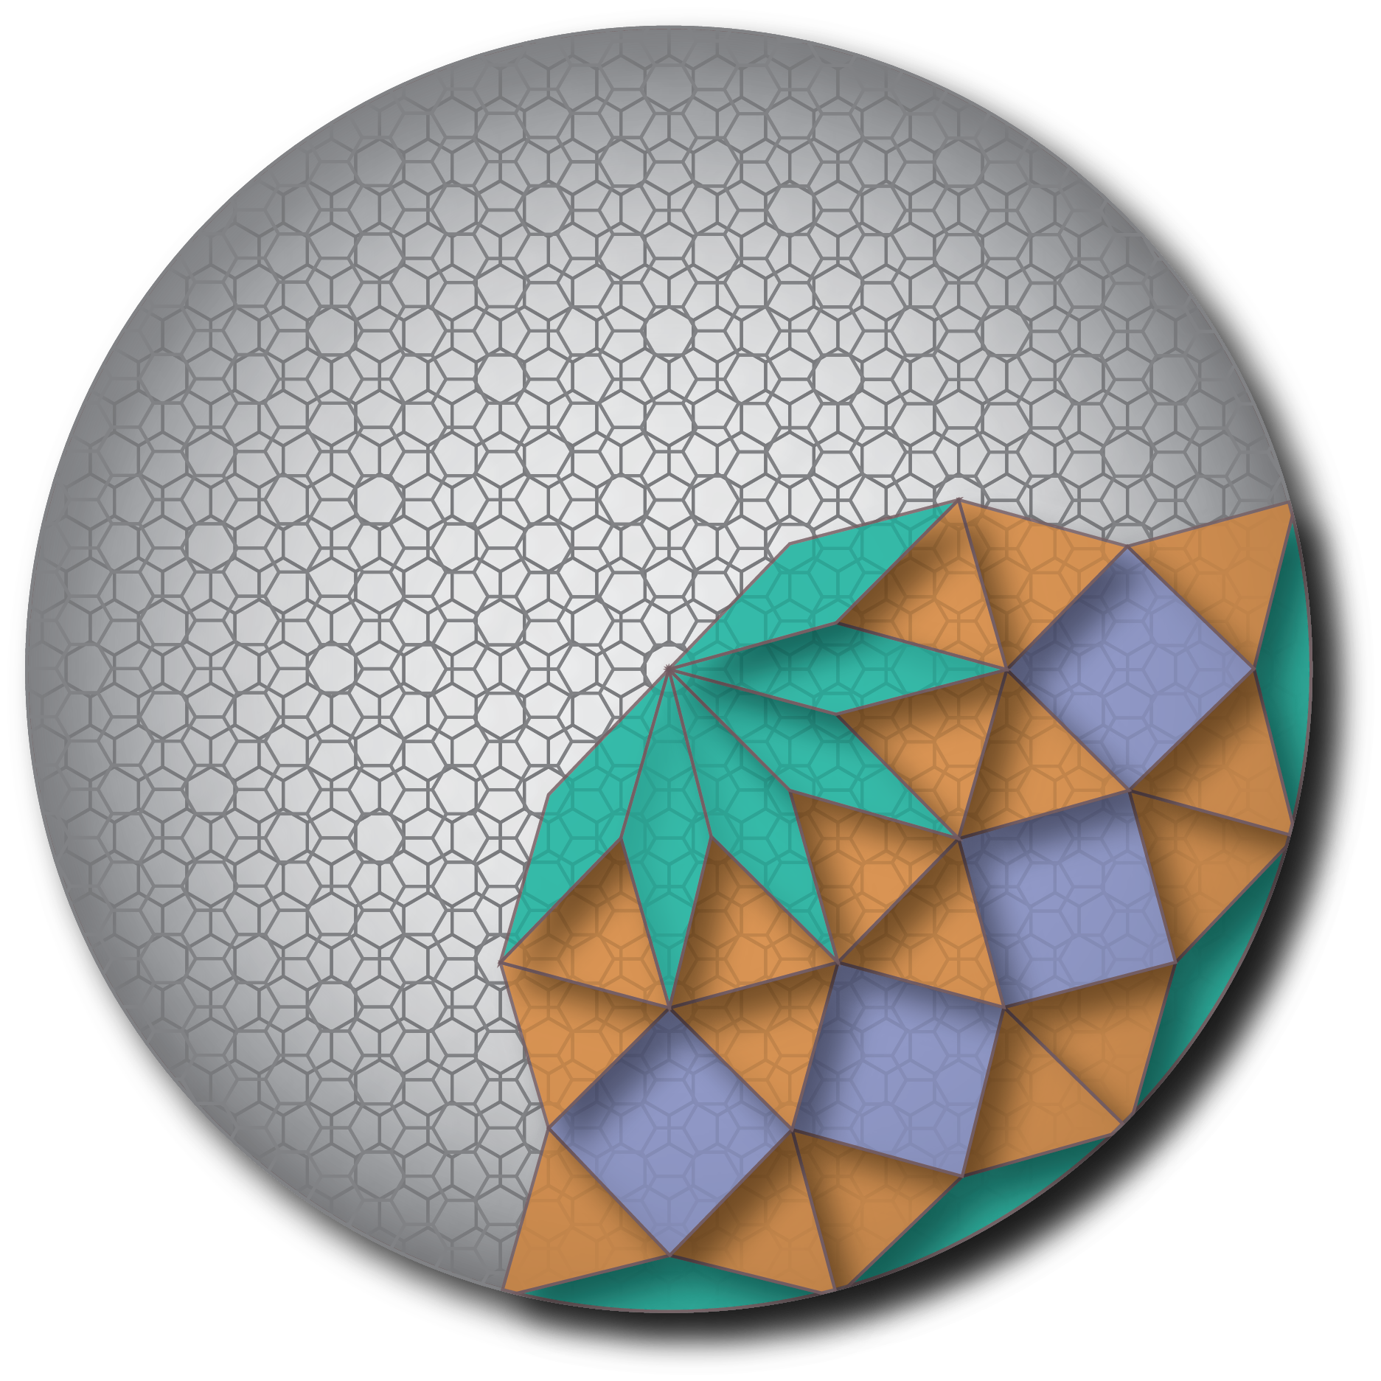
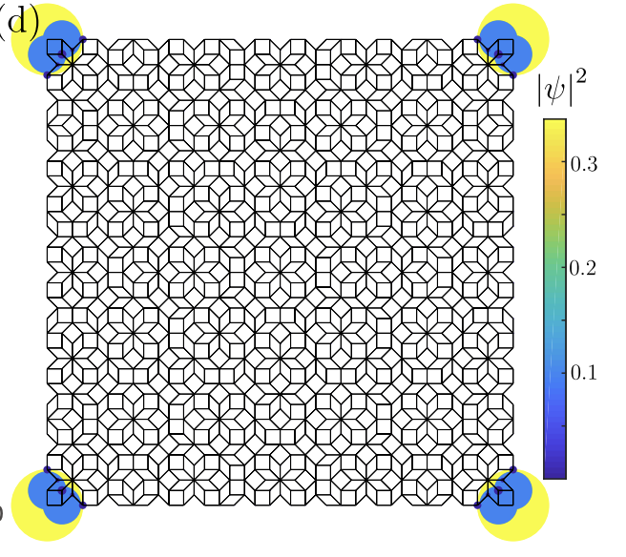
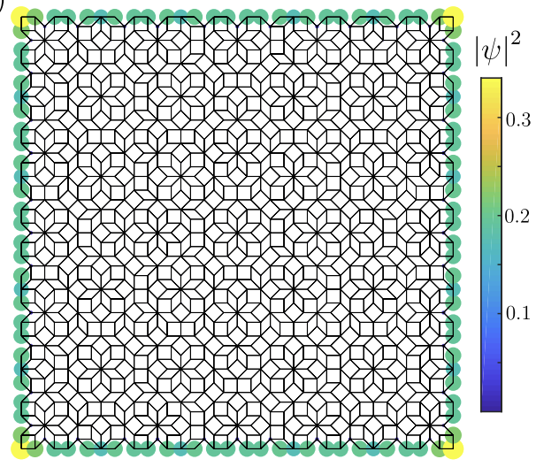

Topological Quasi-Crystalline Phases?
Non-interacting topology: e.g., corner localized modes.
Realized in e.g., bilayer graphene twisted by $30°$

Slide 10
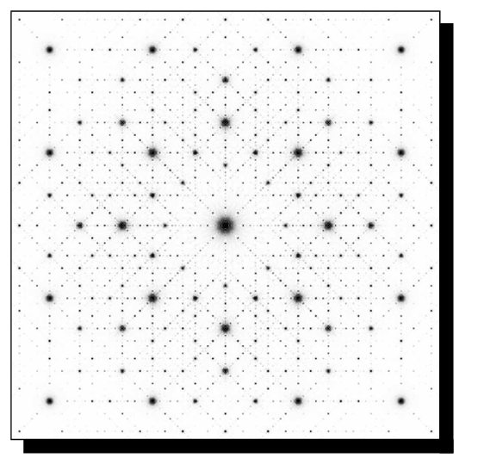
Quasicrystals: Definition
Ammann Beenker tiling
Quasicrystal with 8-fold rotational symmetry
Real space model: tilings
Sharp peaks in Fourier transform

Slide 11
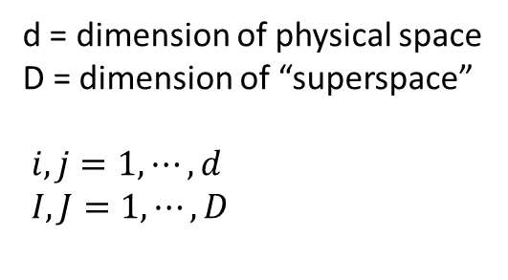
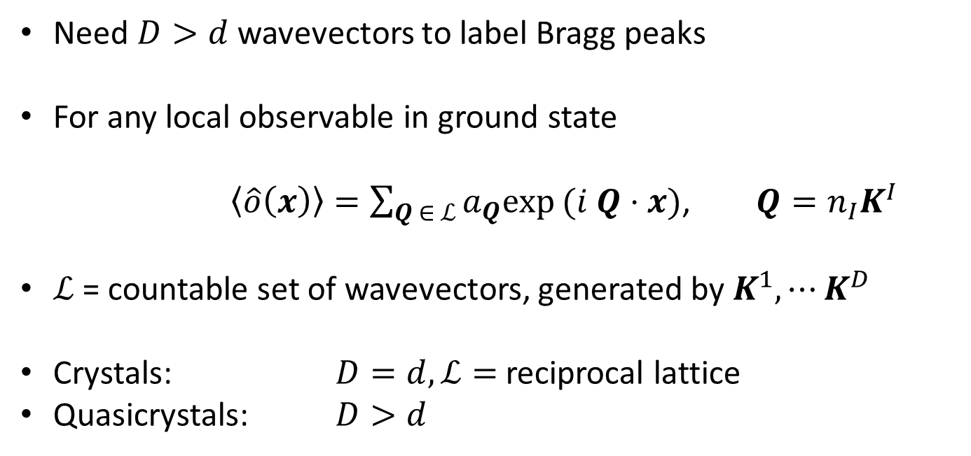
Quasicrystals: Definition
Need $D>d$ wavevectors to label Bragg peaks
For any local observable in ground state
$\left\langle \hat{o}\left(x\right)\right\rangle =\sum_{Q ∈ ℒ}{a_{Q}exp}(i Q⋅x)$, $Q=n_{I}K^{I}$
$ℒ$= countable set of wavevectors, generated by $K^{1},⋯K^{D}$
Crystals: $D=d, ℒ=$reciprocal lattice
Quasicrystals: $D>d$
d = dimension of physical space
D = dimension of “superspace”
$i,j=1,⋯,d$
$I,J=1,⋯,D$

Slide 12
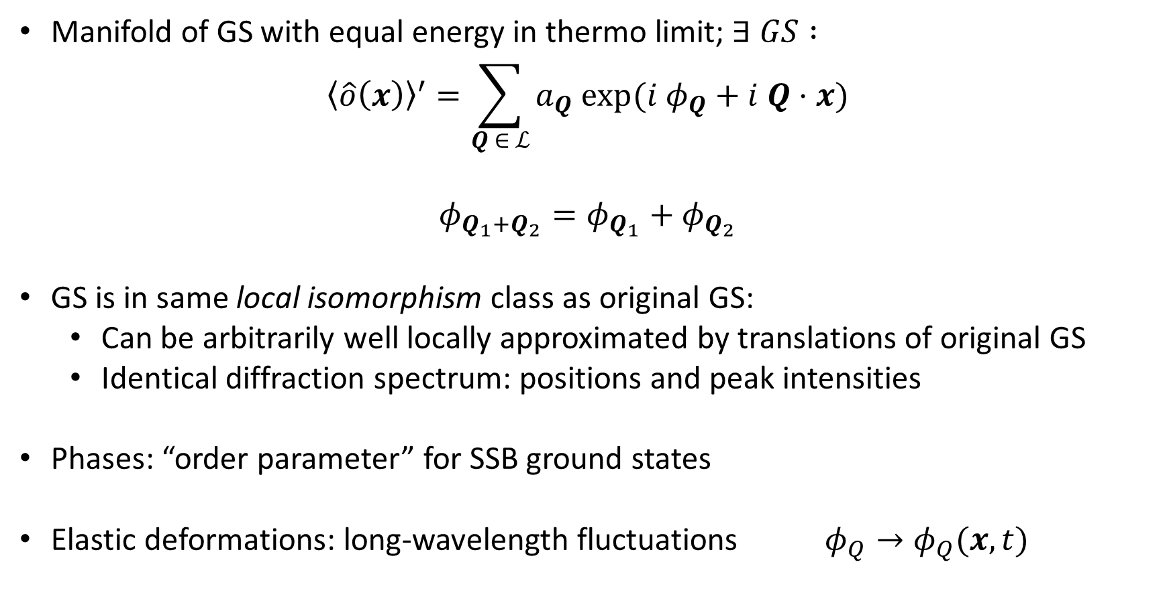

Phonons and Phasons
Manifold of GS with equal energy in thermo limit; $∃ GS :$
$${\left\langle \hat{o}\left(x\right)\right\rangle }^{′}=\sum_{Q ∈ ℒ}{a_{Q} exp(i φ_{Q}+i Q⋅x)}$$
$$φ_{Q_{1}+Q_{2}}=φ_{Q_{1}}+φ_{Q_{2}}$$
GS is in same local isomorphism class as original GS:
  Can be arbitrarily well locally approximated by translations of original GS
  Identical diffraction spectrum: positions and peak intensities
Phases: “order parameter” for SSB ground states
Elastic deformations: long-wavelength fluctuations $φ_{Q}→φ_{Q}(x,t)$
$$[mod 2π]$$

Slide 13
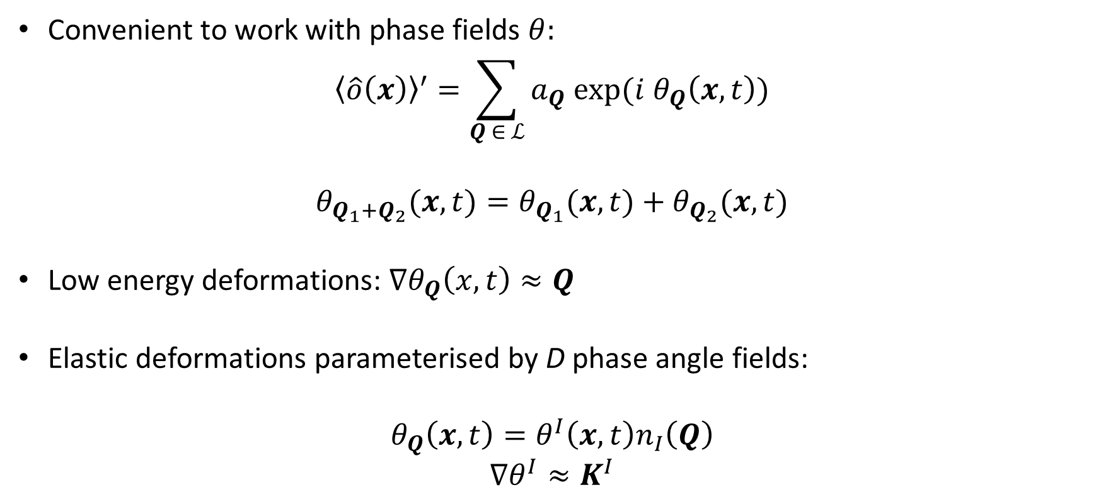



Phonons and Phasons
Convenient to work with phase fields $θ:$
$${\left\langle \hat{o}\left(x\right)\right\rangle }^{′}=\sum_{Q ∈ ℒ}{a_{Q} exp(i θ_{Q}\left(x,t\right))}$$
$$θ_{Q_{1}+Q_{2}}(x,t)=θ_{Q_{1}}(x,t)+θ_{Q_{2}}(x,t)$$
Low energy deformations: $∇θ_{Q}\left(x,t\right)≈Q$
Elastic deformations parameterised by D phase angle fields:
$$θ_{Q}\left(x,t\right)=θ^{I}\left(x,t\right)n_{I}\left(Q\right)$$
$$∇θ^{I}≈K^{I}$$
$$θ_{Q}\left(x,t\right)=φ_{Q}\left(x,t\right)+Q⋅x$$
$$[mod 2π]$$
$$Q=n_{I}K^{I}$$

Slide 14
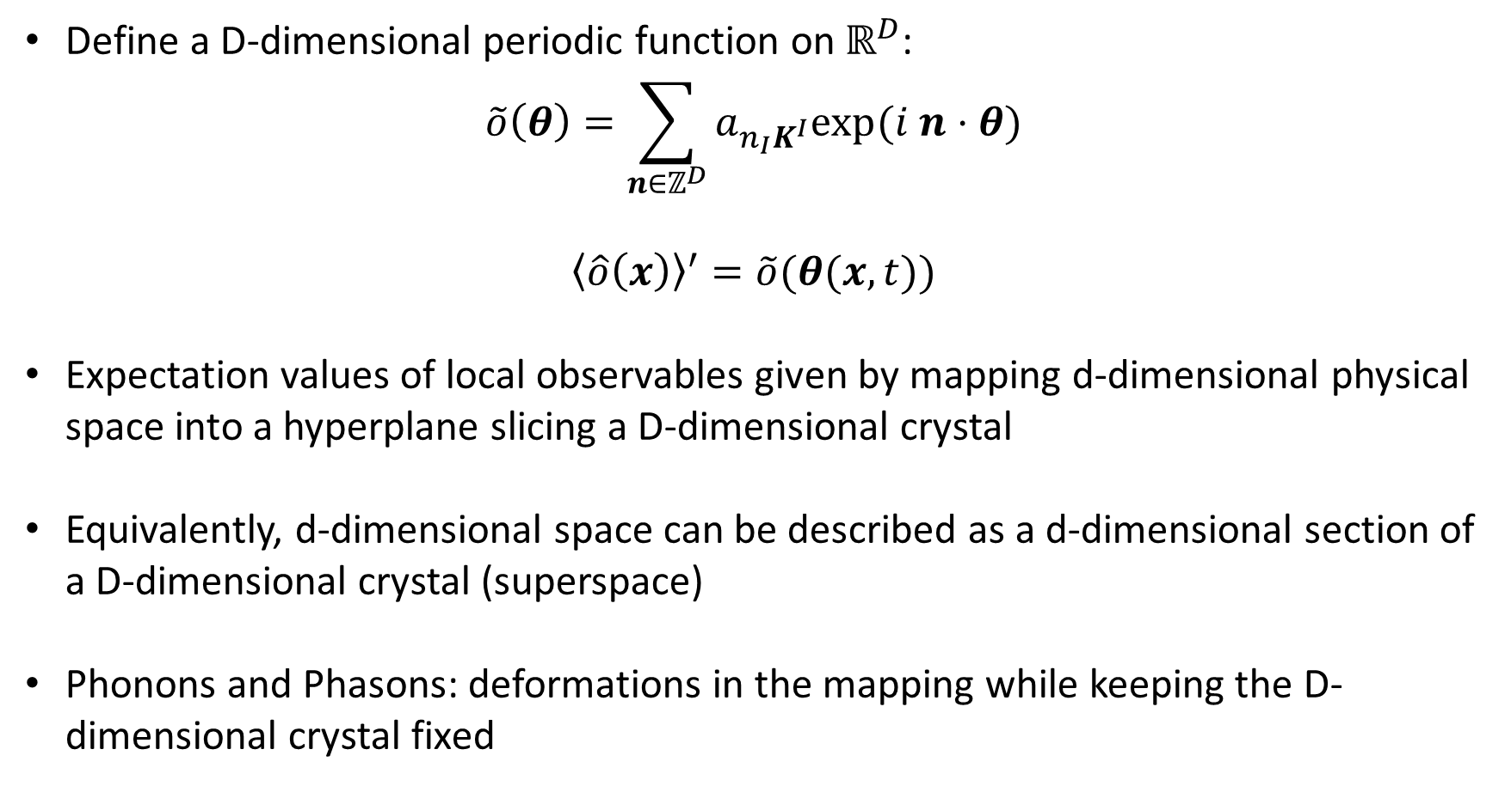
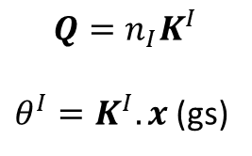
Superspace Description
Define a D-dimensional periodic function on $ℝ^{D}$:
$$\tilde{o}\left(θ\right)=\sum_{n∈ℤ^{D}}{a_{n_{I}K^{I}}exp(i n⋅θ)}$$
$${\left\langle \hat{o}\left(x\right)\right\rangle }^{′}=\tilde{o}(θ(x,t))$$
Expectation values of local observables given by mapping d-dimensional physical space into a hyperplane slicing a D-dimensional crystal
Equivalently, d-dimensional space can be described as a d-dimensional section of a D-dimensional crystal (superspace)
Phonons and Phasons: deformations in the mapping while keeping the D-dimensional crystal fixed
$$Q=n_{I}K^{I}$$
$θ^{I}=K^{I}.x$ (gs)

Slide 15

Superspace Description: Example
d = 1
D = 2
y
x
$$O$$

Slide 16

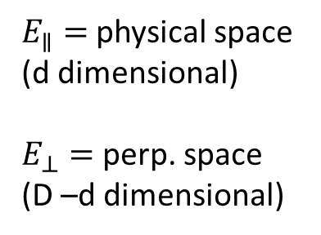


Superspace Description: Example
d = 1
D = 2
y
$$E_{∥}$$
$$α$$
x
$E_{∥}=$ physical space (d dimensional)
$E_{⊥}=$ perp. space
(D –d dimensional)
$$E_{⊥}$$
$$O$$

Slide 17


Superspace Description: Example
d = 1
D = 2
y
$$E_{∥}$$
$$α$$
x
$E_{∥}=$ physical space (d dimensional)
$E_{⊥}=$ perp. space
(D –d dimensional)
$$σ$$
$$E_{⊥}$$
$σ=$ atomic surface
$$O$$

Slide 18
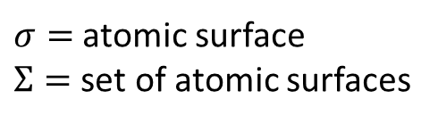
Superspace Description: Example
d = 1
D = 2
y
$$E_{∥}$$
$$α$$
x
$E_{∥}=$ physical space (d dimensional)
$E_{⊥}=$ perp. space
(D –d dimensional)
$$E_{⊥}$$
$σ=$ atomic surface
$Σ=$ set of atomic surfaces
$$O$$

Slide 19
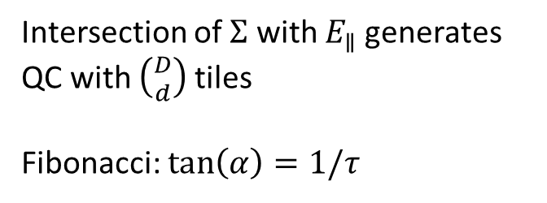
Superspace Description: Example
d = 1
D = 2
y
$$E_{∥}$$
$$α$$
x
S
L
L
$E_{∥}=$ physical space (d dimensional)
$E_{⊥}=$ perp. space
(D –d dimensional)
S
L
S
$$E_{⊥}$$
L
L
S
L
L
$σ=$ atomic surface
$Σ=$ set of atomic surfaces
S
L
Intersection of $Σ$ with $E_{∥}$generates QC with $\left({D \atop d}\right)$tiles
Fibonacci: $tan\left(α\right)=1/τ$
$$O$$

Slide 20
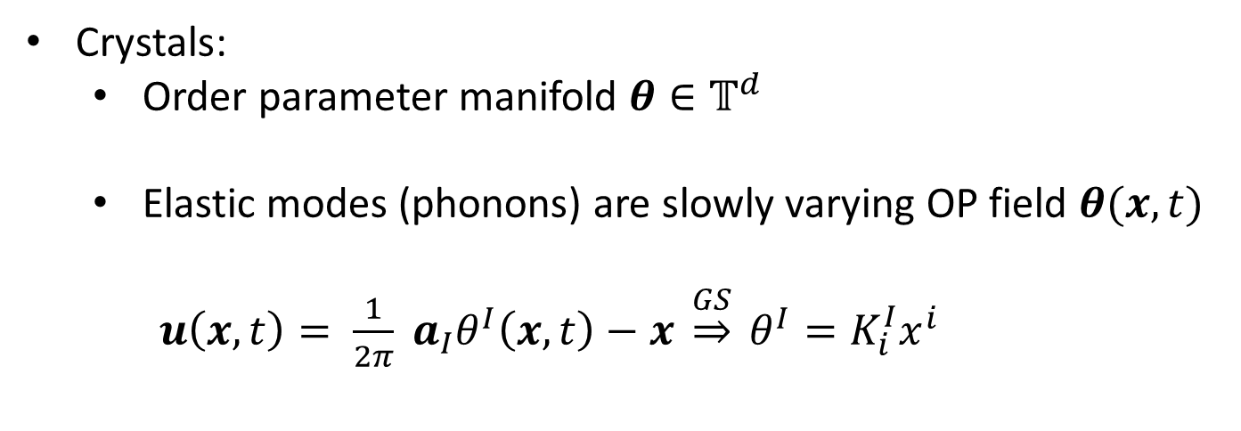
Can quasicrystallinity protect topological phases ?
Crystals:
  Order parameter manifold $θ∈𝕋^{d}$
  Elastic modes (phonons) are slowly varying OP field $θ(x,t)$
  $u\left(x,t\right)= \frac{1}{2π} a_{I}θ^{I}\left(x,t\right)−x \underset{⇒}{GS} θ^{I}=K_{i}^{I}x^{i}$

Slide 21
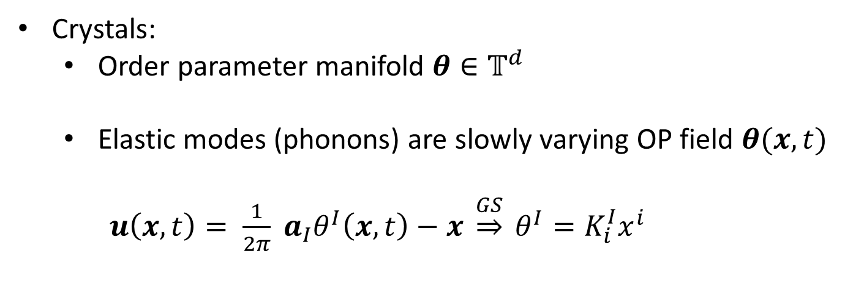
Can quasicrystallinity protect topological phases ?
Crystals:
  Order parameter manifold $θ∈𝕋^{d}$
  Elastic modes (phonons) are slowly varying OP field $θ(x,t)$
  $u\left(x,t\right)= \frac{1}{2π} a_{I}θ^{I}\left(x,t\right)−x \underset{⇒}{GS} θ^{I}=K_{i}^{I}x^{i}$
2D Topological insulator
Crystals have exact lattice translation symmetry
Translation symmetry protects topological phase e.g. weak topological insulators
Translation symmetry

Slide 22
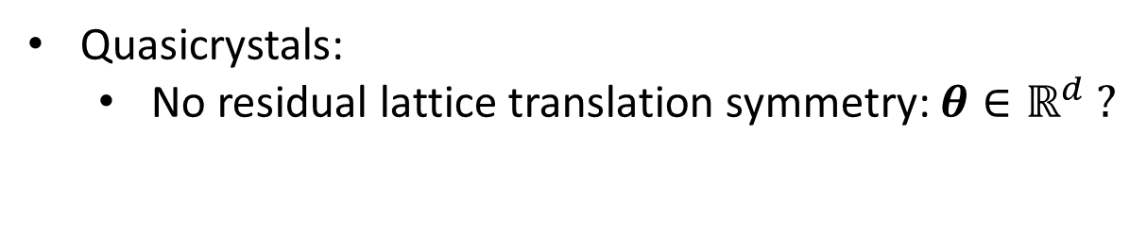
Translation Quasi-Symmetry
Quasicrystals:
  No residual lattice translation symmetry: $θ∈ℝ^{d} ?$

Slide 23
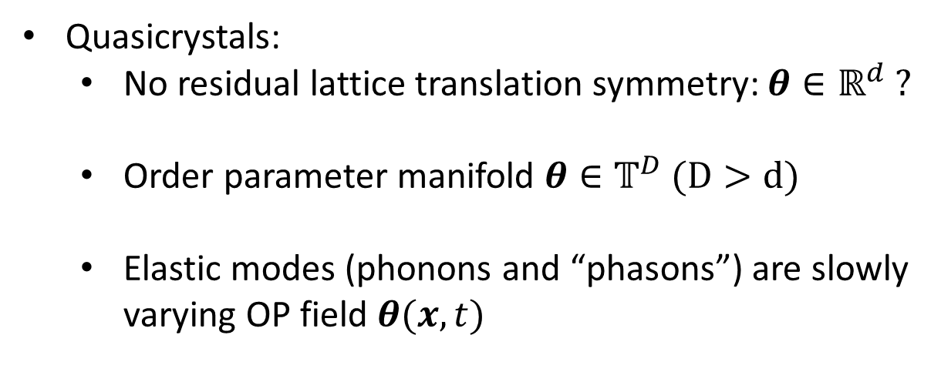
Translation Quasi-Symmetry
Quasicrystals:
  No residual lattice translation symmetry: $θ∈ℝ^{d} ?$
  Order parameter manifold $θ∈𝕋^{D} (D>d)$
  Elastic modes (phonons and “phasons”) are slowly varying OP field $θ(x,t)$

Slide 24
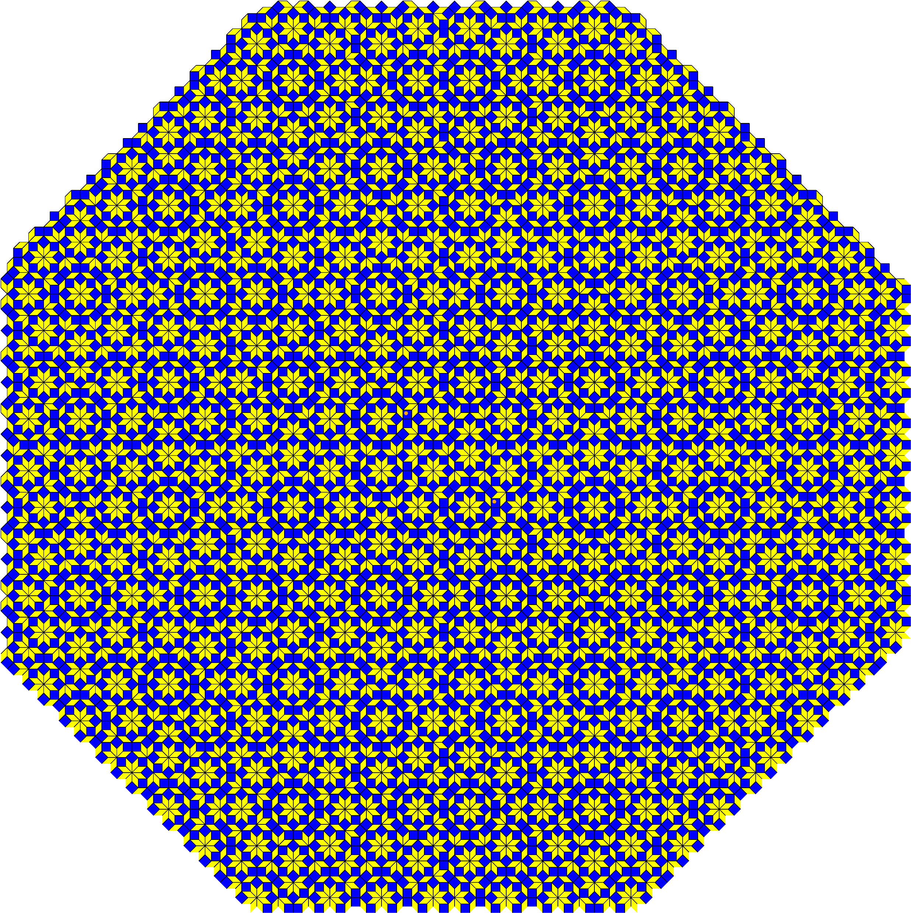
Translation quasi-symmetry

Slide 25
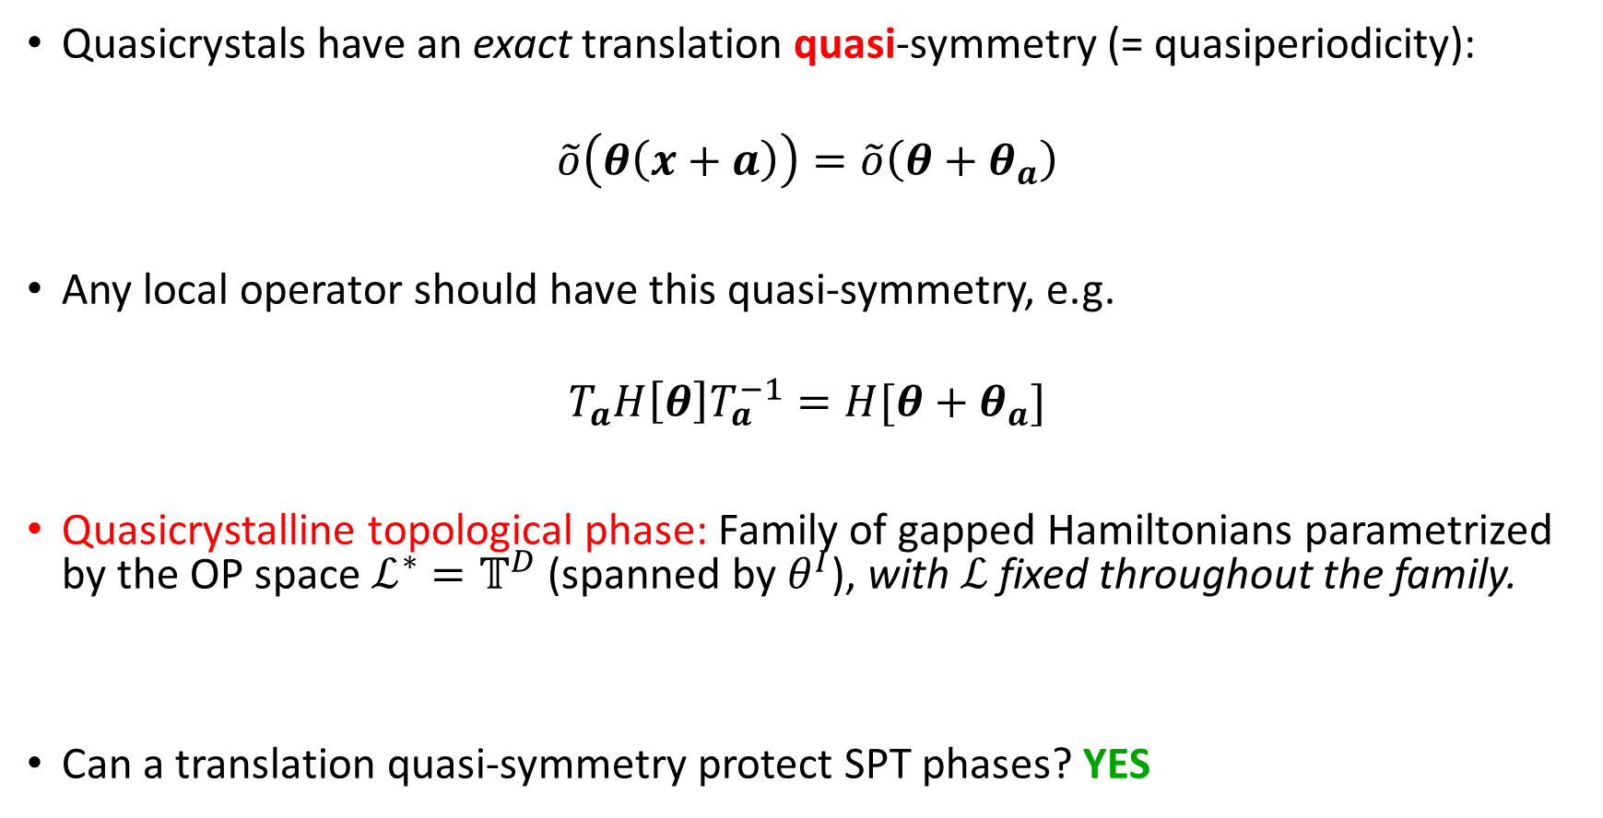

Quasicrystalline Topological Phases
Quasicrystals have an exact translation quasi-symmetry (= quasiperiodicity):
$$\tilde{o}\left(θ\left(x+a\right)\right)=\tilde{o}\left(θ+θ_{a}\right)$$
Any local operator should have this quasi-symmetry, e.g.
$$T_{a}H\left[θ\right]T_{a}^{−1}=H[θ+θ_{a}]$$
Quasicrystalline topological phase: Family of gapped Hamiltonians parametrized by the OP space $ℒ^{∗}=𝕋^{D}$ (spanned by $θ^{I}$), with $ℒ$ fixed throughout the family.
Can a translation quasi-symmetry protect SPT phases? YES
$$θ_{a}^{I}=K^{I}.a$$
In a crystal, equivalent to demanding that GS respects discrete translation symmetry of the lattice.

Slide 26
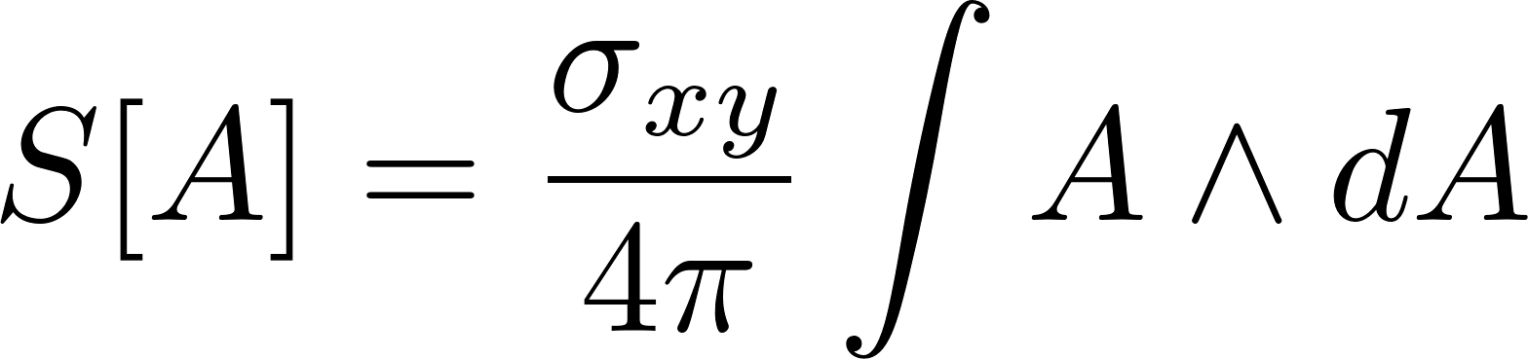
SPTs and quantized topological terms
We can understand SPT phases by considering their quantized responses
For example, if we couple a (2+1)-D system with a U(1) symmetry to a background gauge field A, we can have a topological term
For crystalline symmetries, need a notion of gauging spatial symmetries
  Gives correct classification, but formal
  Not clear how to generalise to quasi-crystals
[Thorngren and Else, PRX 2017]
[Manjunath and Barkeshli, PRR 2021; arXiv:2012.11603]

Slide 27
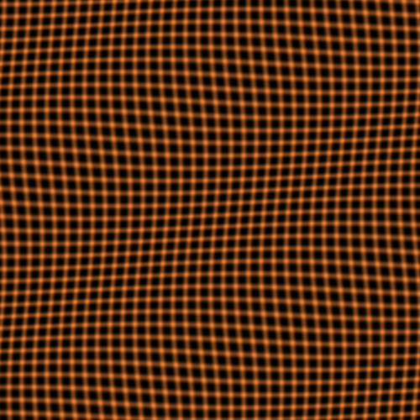
Topological terms for phonons
Crystalline SPTs are classified by quantized topological terms
in the elasticity theory

Slide 28

Translation SPTs with U(1) symmetry in (1+1)-D
SPTS classified by an integer
(charge per unit cell)

Slide 29

Translation SPTs with U(1) symmetry in (1+1)-D

Slide 30
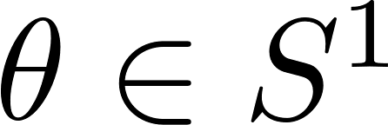
Translation SPTs with U(1) symmetry in (1+1)-D
Order parameter

Slide 31

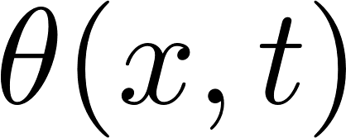
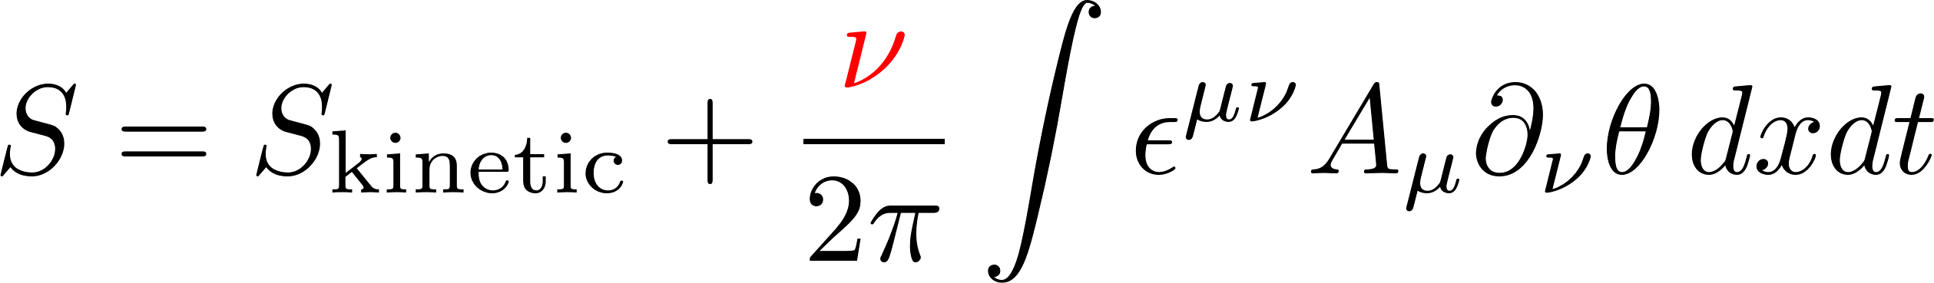
Translation SPTs with U(1) symmetry in (1+1)-D
Order parameter
Phonons correspond to allowing the order parameter field to be slowly varying
Couple to a background gauge field for the U(1) symmetry
Phonon action

Slide 32
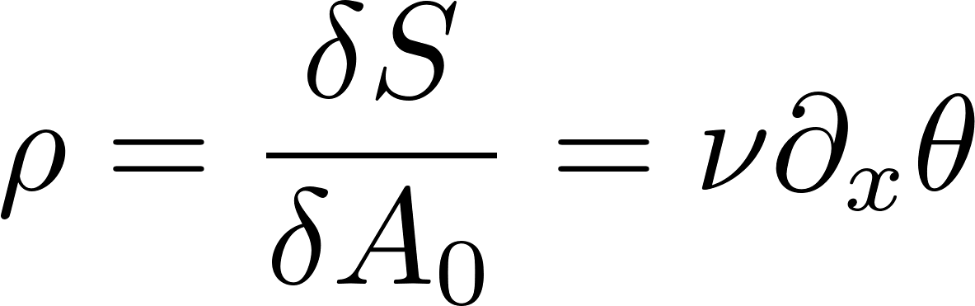
Translation SPTs with U(1) symmetry in (1+1)-D
Charge density

Slide 33

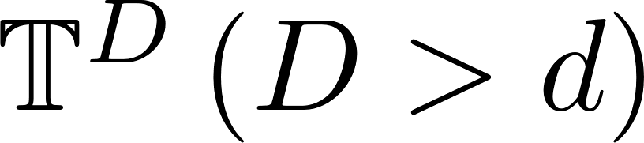
Recall: In d spatial dimensions
Crystals have order parameter manifold
Quasicrystals have order parameter manifold

Slide 34
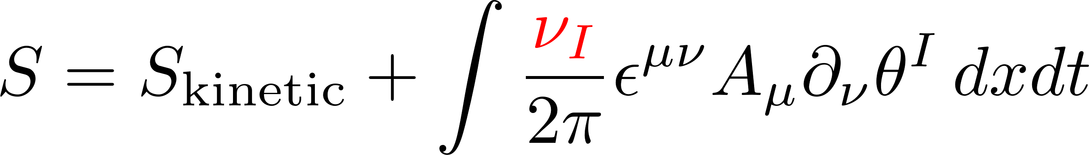
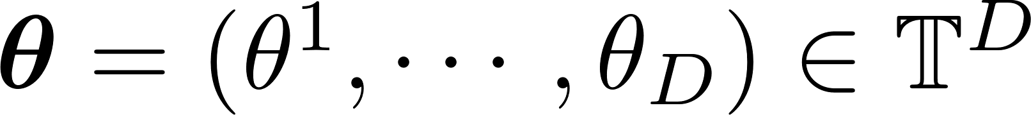
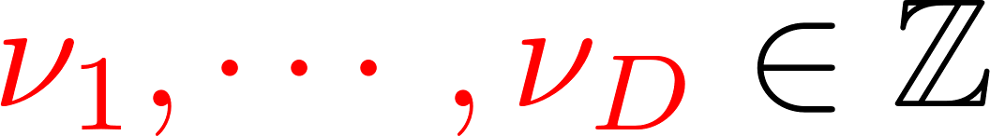
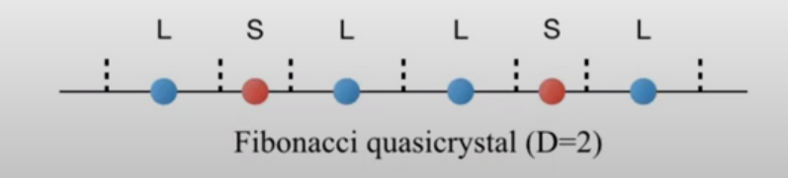
Topological actions for a quasicrystal in (1+1)-D
The fields
Quantized coefficients
Topological term gives the average charge per type of tile (prototile)

Slide 35
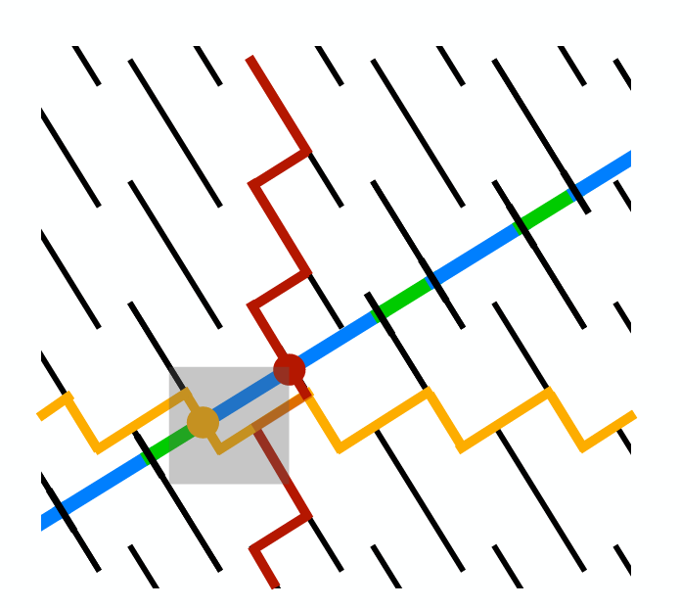
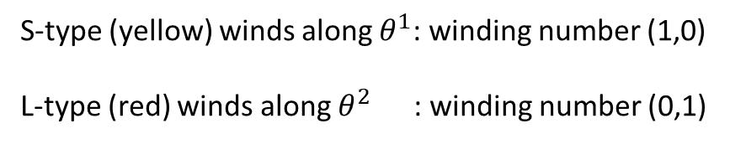
Atomic Surface Interpretation
Associate atomic species to each type of tile
Classify atomic surfaces into different types
Can make atomic surfaces closed curves without affecting QC structure
S-type (yellow) winds along $θ^{1}$: winding number (1,0)
L-type (red) winds along $θ^{2}$ : winding number (0,1)

Slide 36
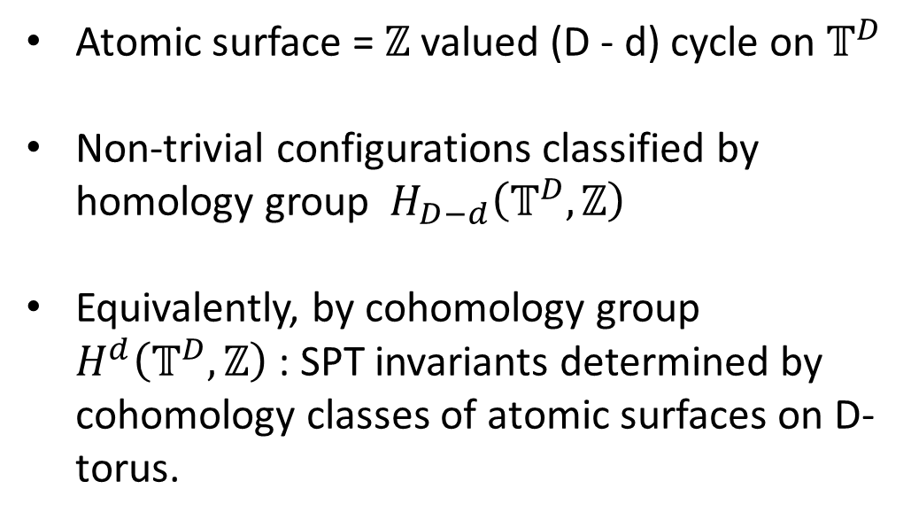
Atomic Surface Interpretation
Atomic surface = $ℤ$ valued (D - d) cycle on $𝕋^{D}$
Non-trivial configurations classified by homology group $H_{D−d}\left(𝕋^{D},ℤ\right)$
Equivalently, by cohomology group $H^{d}\left(𝕋^{D},ℤ\right)$ : SPT invariants determined by cohomology classes of atomic surfaces on D-torus.
S-type (yellow) winds along $θ^{1}$: winding number (1,0)
L-type (red) winds along $θ^{2}$ : winding number (0,1)

Slide 37
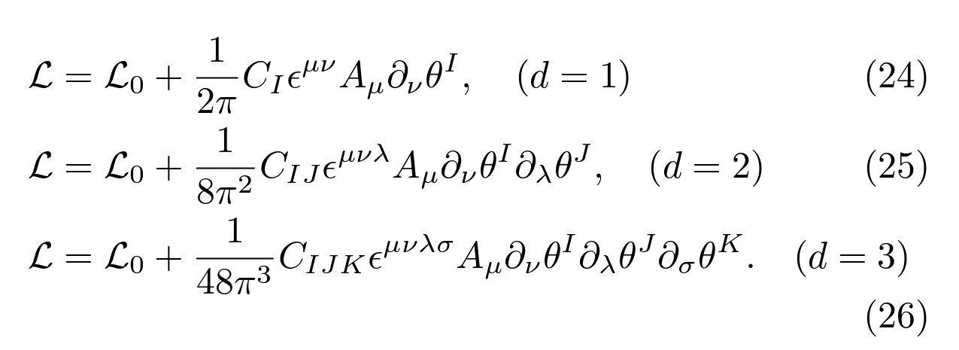
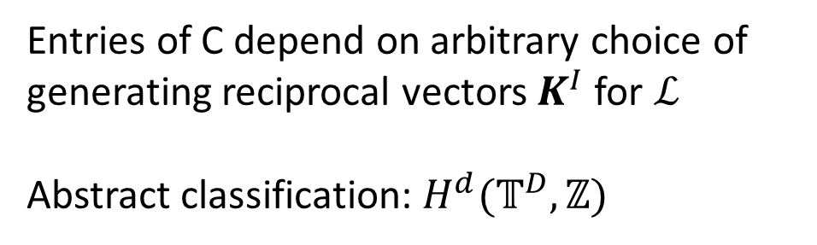
Topological actions for a quasicrystal with U(1)
Entries of C depend on arbitrary choice of generating reciprocal vectors $K^{I}$ for $ℒ$
Abstract classification: $H^{d}(𝕋^{D},ℤ)$

Slide 38
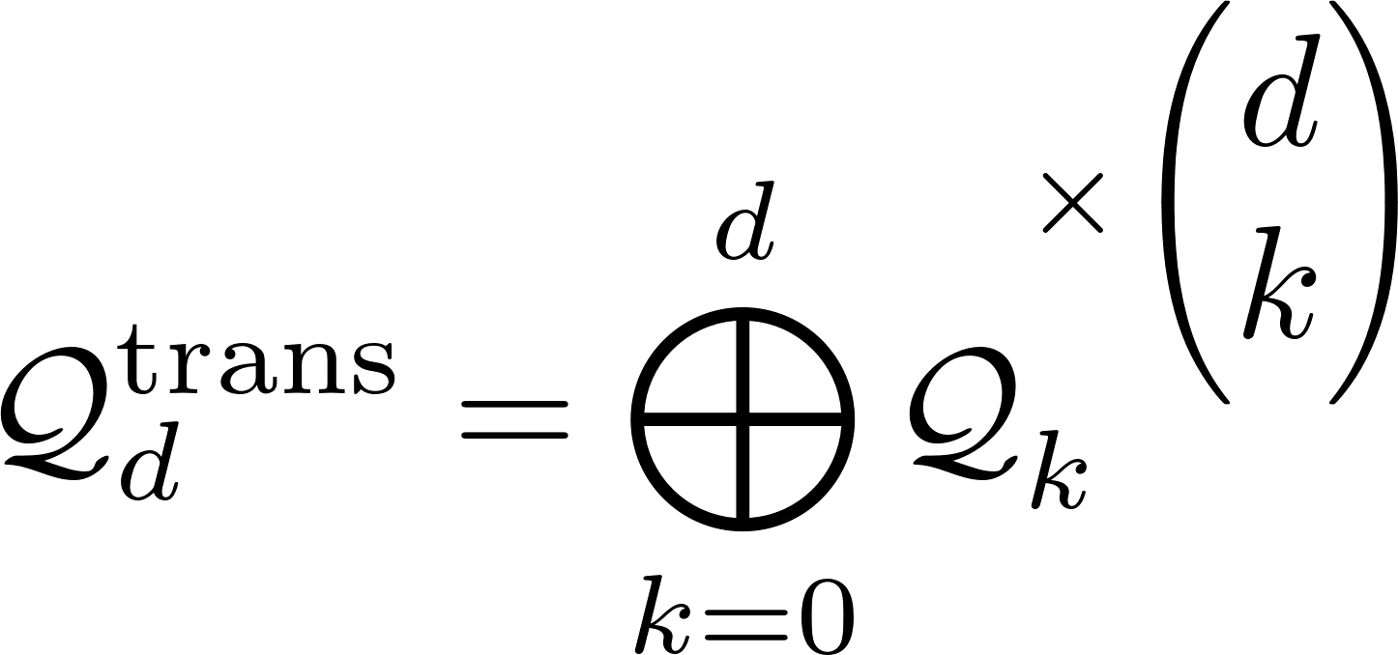

General classification of translation SPTs in crystals
is the classification of “strong” SPTs
in k spatial dimensions
For example in d=2:

Slide 39
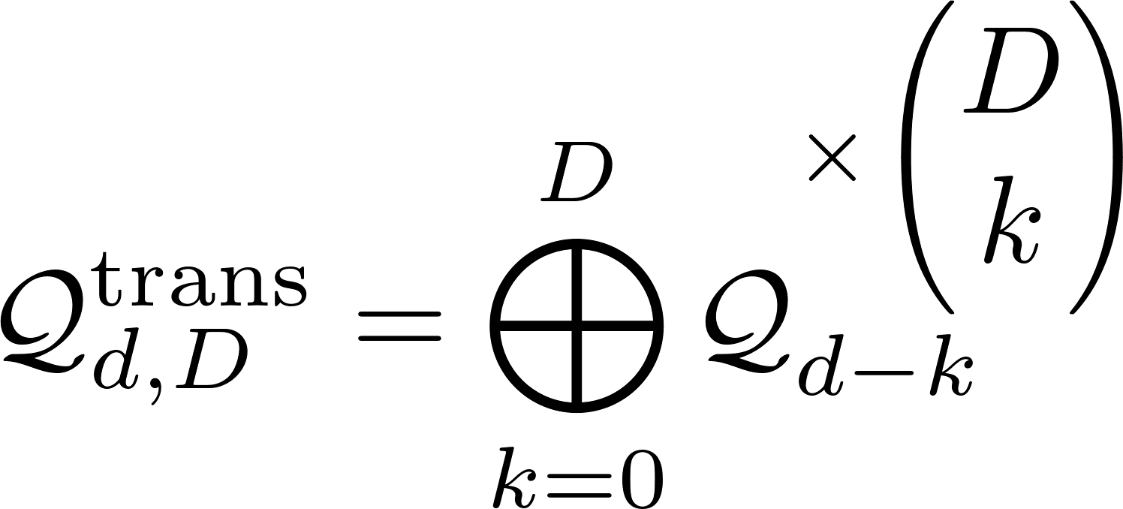
General classification of translation quasi-symmetry SPTs in quasicrystals
is the classification of “strong” SPTs
in k spatial dimensions
For example in d=2, D=4:
Strong SPTs
Weak SPTs
???!

Slide 40
Weak quasi-crystalline SPT phases
Weak SPTs
0D SPT (charge)

Slide 41
Weak quasi-crystalline SPT phases
Weak SPTs
1D SPT

Slide 42
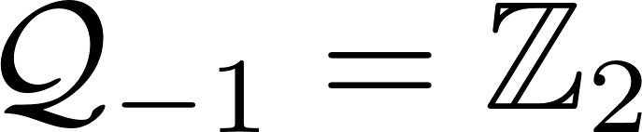
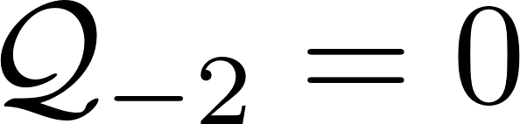
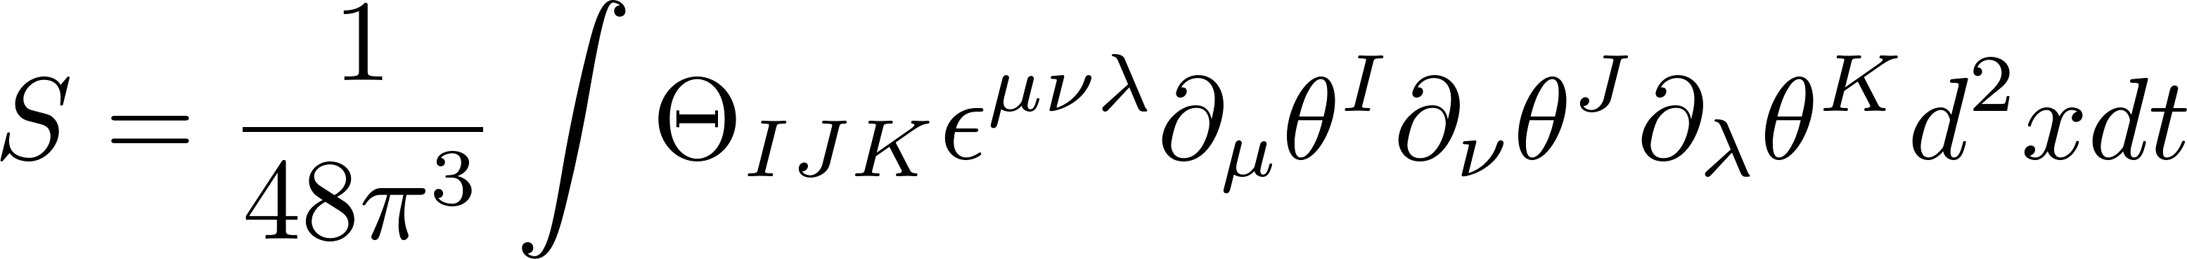
Intrinsically quasi-crystalline topological phases
Intrinsically quasicrystalline
SPT phases
Strong SPTs
Weak SPTs
???!
With time-reversal symmetry:
“Theta-term”

Slide 43
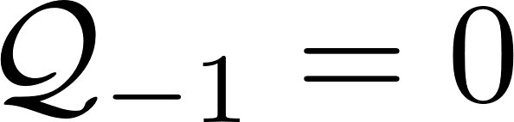

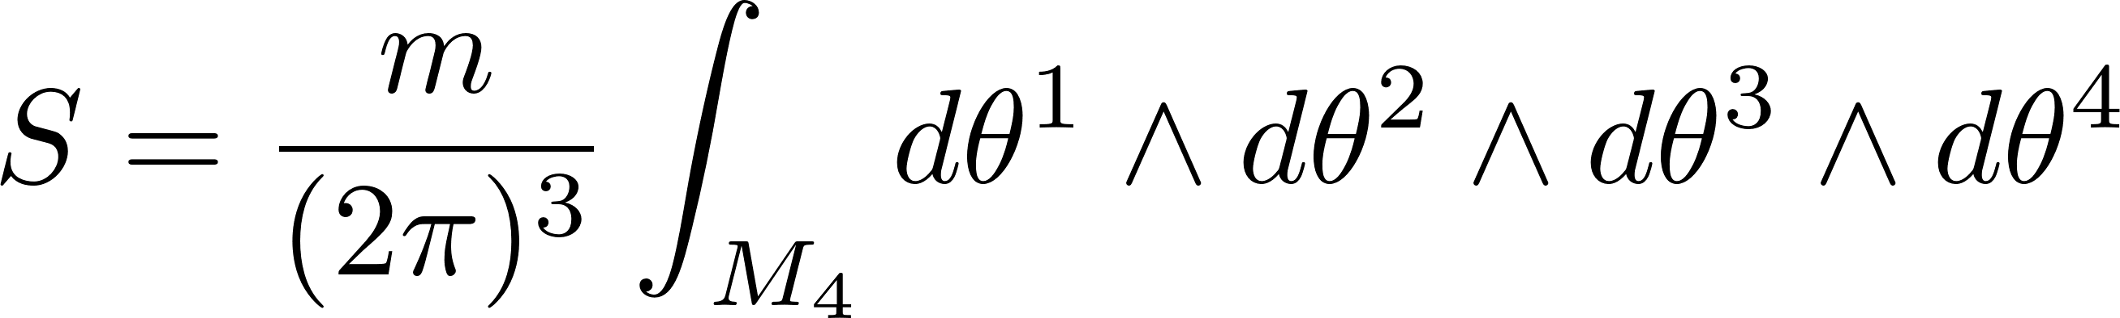
Intrinsically quasi-crystalline topological phases
Strong SPTs
Weak SPTs
Intrinsically quasicrystalline
SPT phases
With time-reversal symmetry:
Without time-reversal symmetry:
Related to “higher-dimensional Berry’s phase”
[Kapustin and Spodyneiko, PRB 2020]
“Theta-term”
“Wess-Zumino” type action

Slide 44
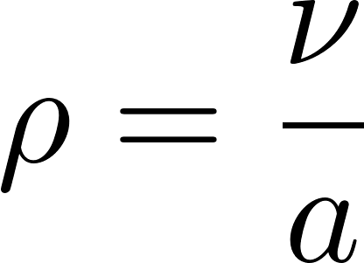









Application: LSM-OH theorem for quasicrystals
We consider 1D systems with a U(1) symmetry. What is the density in an insulator?
Crystal:
Quasicrystal:
[LSM-OH theorem]
[ = lattice constant]
Dense
(but not continuous)
[See also: gap labelling theorems for free-fermions]

Slide 45





Application: mobility of dislocations
Crystalline case
Burgers vector

Slide 46


Application: mobility of dislocations
Crystalline case
Burgers vector

Slide 47
Application: mobility of dislocations
Crystalline case
Burgers vector

Slide 48





Application: mobility of dislocations
Crystalline case
With symmetry, and if the SPT invariant , then dislocations can only move in the direction of their Burgers vector
Burgers vector

Slide 49



Application: mobility of dislocations
Quasicrystalline case
Can determine the direction in which dislocations can move (depends on )
Always exists at least one direction along which they are mobile (i.e., at most “lineons”)

Slide 50
Crystalline equivalence principle
[Else, Thorngren, PRX 2018]
Crystalline topological phases with space group G
Topological phases with internal symmetry G

Slide 51

Quasicrystalline equivalence principle
Quasicrystalline topological phases with a point-group symmetry
Topological phases with internal symmetry $\hat{G}$
$\hat{G}$is the space-group of a higher-dimensional crystal

Slide 52
Outlook
Physical signatures of quasicrystalline topological phases, particularly intrinsically quasicrystalline phases?
Boundary signatures?
  General results on bulk-boundary correspondence forthcoming
  Can also study quasicrystalline boundaries of a crystalline bulk
Microscopic models and physical realisations?
Non-invertible phases? Fractonic behaviour in lower-dimensions?
Thank you

